Slide 1
How can CSO-s and academic institutions partner together with Erasmus+ funding, to support skills in the non-profit sector?
skills DEVELOPMENT through enhanced cooperation among
CSO and Academia
Ana Mullanji
Contact Point Erasmus+ Youth & ESC Albania

Slide 2
EVOLUTION OF ERASMUS+
2007-2013
Life Long Learning Program
- Tempus IV
- Erasmus Mundus
- Youth in Action
2021-2027
Erasmus+: Education, Training, Youth and Sport
- KA1- Mobility of individuals
- KA2-Cooperation among organisations& Institutions
- KA3 – Policy Development& Cooperation
Jean Monnet
2014-2020
Erasmus+ : Education, Training, Youth and Sport
- KA1: Learning Mobility
- KA2: Cooperation for innovation and exchange of good practices
- KA3: Support for policy reform / Jean Monnet

Slide 3
DID YOU KNOW THAT…
3 of 4 former Erasmus+ students say they have a better understanding of what they want to do in their future careers when
they return from abroad.
... 1 of 3 Erasmus+ trainees
are offered a position
by the company they trained in.
… 1 of 3 youth mobility
participants comes
from a disadvantaged background.
Over the last three decades,
more than 10 million people have participated in Erasmus+ or its predecessor programmes.
…1 of 2 universities have
introduced new digital tools in teaching and learning activities
as a direct result of their
Erasmus+ project.
... Erasmus+ is helping to address
match-fixing and doping in sports.

Slide 4


SUPPORT STRUCTURES E+
SALTO RESOURCE CENTRES SUPPORTING ERASMUS+ &
TRANSVERSAL PRIORITIES
National Erasmus+ Offices

Slide 5
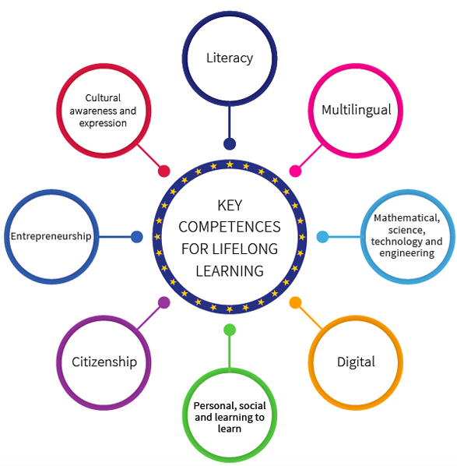
ERASMUS + OPPORTUNITIES FOR WB
Virtual Exchanges – KA1
CBY – KA2
CBHE – KA2
CB VET – KA2
CB Sport – KA2
Other special calls

Slide 6
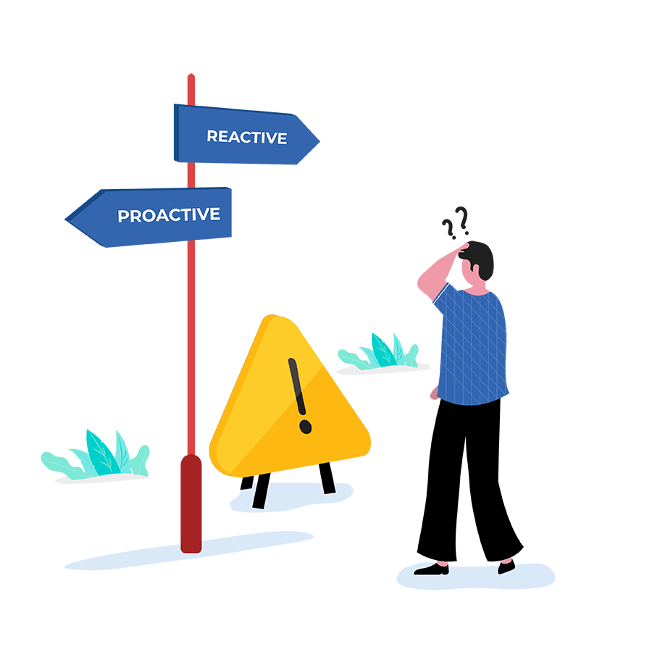

COOPERATION CHALLENGES
Sporadic cooperation among CSO-s and Academic Institutions;
Sustainability of partnerships;
Reactive approach versus Proactive approach;
Recognition of expertise;

Slide 7
OPPORTUNITIES FOR ENHANCED COOPERATION
Building bridges of cooperation and getting to know each other;
Identifying needs and setting up common goals;
Recognition and appreciation of expertise;
Partner in E+ projects together;
Promote Learning Mobility and other cooperation schemes;
Research and Innovation and Leverage technology (Virtual YE);
Disseminate and scale (national and regional level);

Slide 8

Thank you!
ANA MULLANJI
ana.mullanji@beyondbarriers.org
www.beyondbarriers.org

