Slide 1

Micro-credentials, lifelong learning and flexible learning options: to assure quality of short-term courses
Siria Taurelli, ETF
EU TACSO 3 and 2023 EU Year of Skills:
Skills for Non-Profit Organisations in the Western Balkans and Türkiye
Tirana, 20-21 November, 2023
GOVERNANCE LEARNING, ACTION, DIALOGUES

Slide 2

Accessibility and flexibility of learning
European Year of Skills is a call for action on skills
Skills demand is changing due to new technologies, the green and digital transformation and new forms of work, and due to multiple transitions in life (education-employment, employment-learning, job-job, in-out labour market)
Flexibility in learning: responding to individual needs, short-term courses, face-to-face, online and offline
Accessibility for all especially those who needs it the most
      EYS’ twofold meaning for CSOs: learners and providers of learning

Slide 3

Individual needs vs recognition
Diversity of learners and diverse providers also outside formal education
To ensure that the results of short training courses are portable and learning achievements recognised
Micro-credentials can be part of the solution

Slide 4
Individual needs vs recognition (2)
Features of micro-credentials:
  reflect both an individual learning experience and the result of an assessment of knowledge, skills and competences
  articulation with a recognised qualifications or part of it, to draw a path from micro-credentials to qualifications
  integration into formalised education and training systems and portability
Possible obstacles:
  relevant qualifications to connect with may not exist (yet), or be difficult to attain or comply with in full
  accreditation of institution and/or programme may take time
Other measures to consider:
  accreditation of short-term courses based on quality criteria
  transitional accreditation measures based on quality criteria

Slide 5

ETF guidelines on micro-credentials
Micro-credentials are taking off | ETF (europa.eu)
How to use ETF guidelines for designing, issuing and recognising micro-credentials? | ETF (europa.eu) ==> introduction and link to the guidelines
Mapping out ways to implement micro-credentials | ETF (europa.eu)
A European approach to micro-credentials | European Education Area (europa.eu)

Slide 6
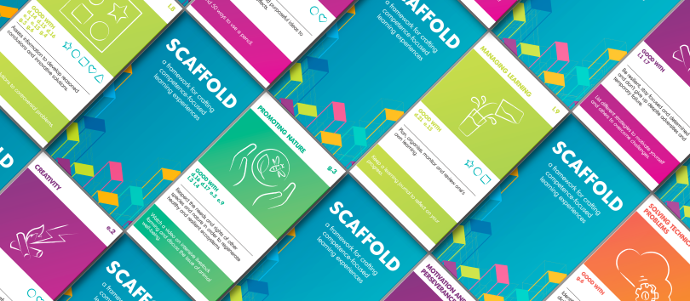
Scaffold: teaching and learning key competences
Scaffold is based on the European competence frameworks for digital, entrepreneurship, sustainability, as well as personal, social and learning to learn competences

Slide 7
Scaffold: teaching and learning key competences
Scaffold aims at making European competence frameworks simple and easy to use by teachers and by all educators
It combines learning activities with essential knowledge of what each competence entails, structured with instructional and assessment design prompts
It guides teachers/educators in addressing these competences in both formal and non-formal learning contexts, by supporting them to design learning activities, from planning to assessment

Slide 8
A guide to teaching and learning key competences
Scaffold consists of a deck of 102 cards created by the European Training Foundation (ETF) and the Joint Research Centre (JRC) with the Directorate General for Employment and Social Affairs (DG EMPL) of the European Commission
Scaffold: a card game to revolutionise teaching | ETF (europa.eu)
Guide to Scaffold | ETF (europa.eu)
(983) Scaffold: table game for educators - YouTube

Slide 9
Thank you for your time and contribution!
Contact us: glad@etf.europa.eu
@ETF OpenSpace/GLAD
GOVERNANCE LEARNING, ACTION, DIALOGUES

