Slide 1

Providing skills for the non-profit sector in Albania
Tirana, 2023

Slide 2
Partners Albania for Change and Development
PA is an independent Albanian NPO established in 2001, working to support civil society and facilitate inter-sector cooperation, in order to strengthen democratic institutions and advance economic development.
Member of Partners Network, a partnership of 19 independent, local organizations in Europe, the Americas, Africa, and the Middle East working for peaceful and democratic change;
Also, a member of several global, European and regional networks such as BCSDN, ECAS, DIESIS, ANNA LINDH, WINGS, Alliance for Peacebuilding, CHANCE – Civil Hub Against organised Crime in Europe, etc;
Member of the Code of Standards for Civil Society Organizations and plays the role of Secretariat of the Code through the National Resource Centre for Civil Society in Albania.

Slide 3
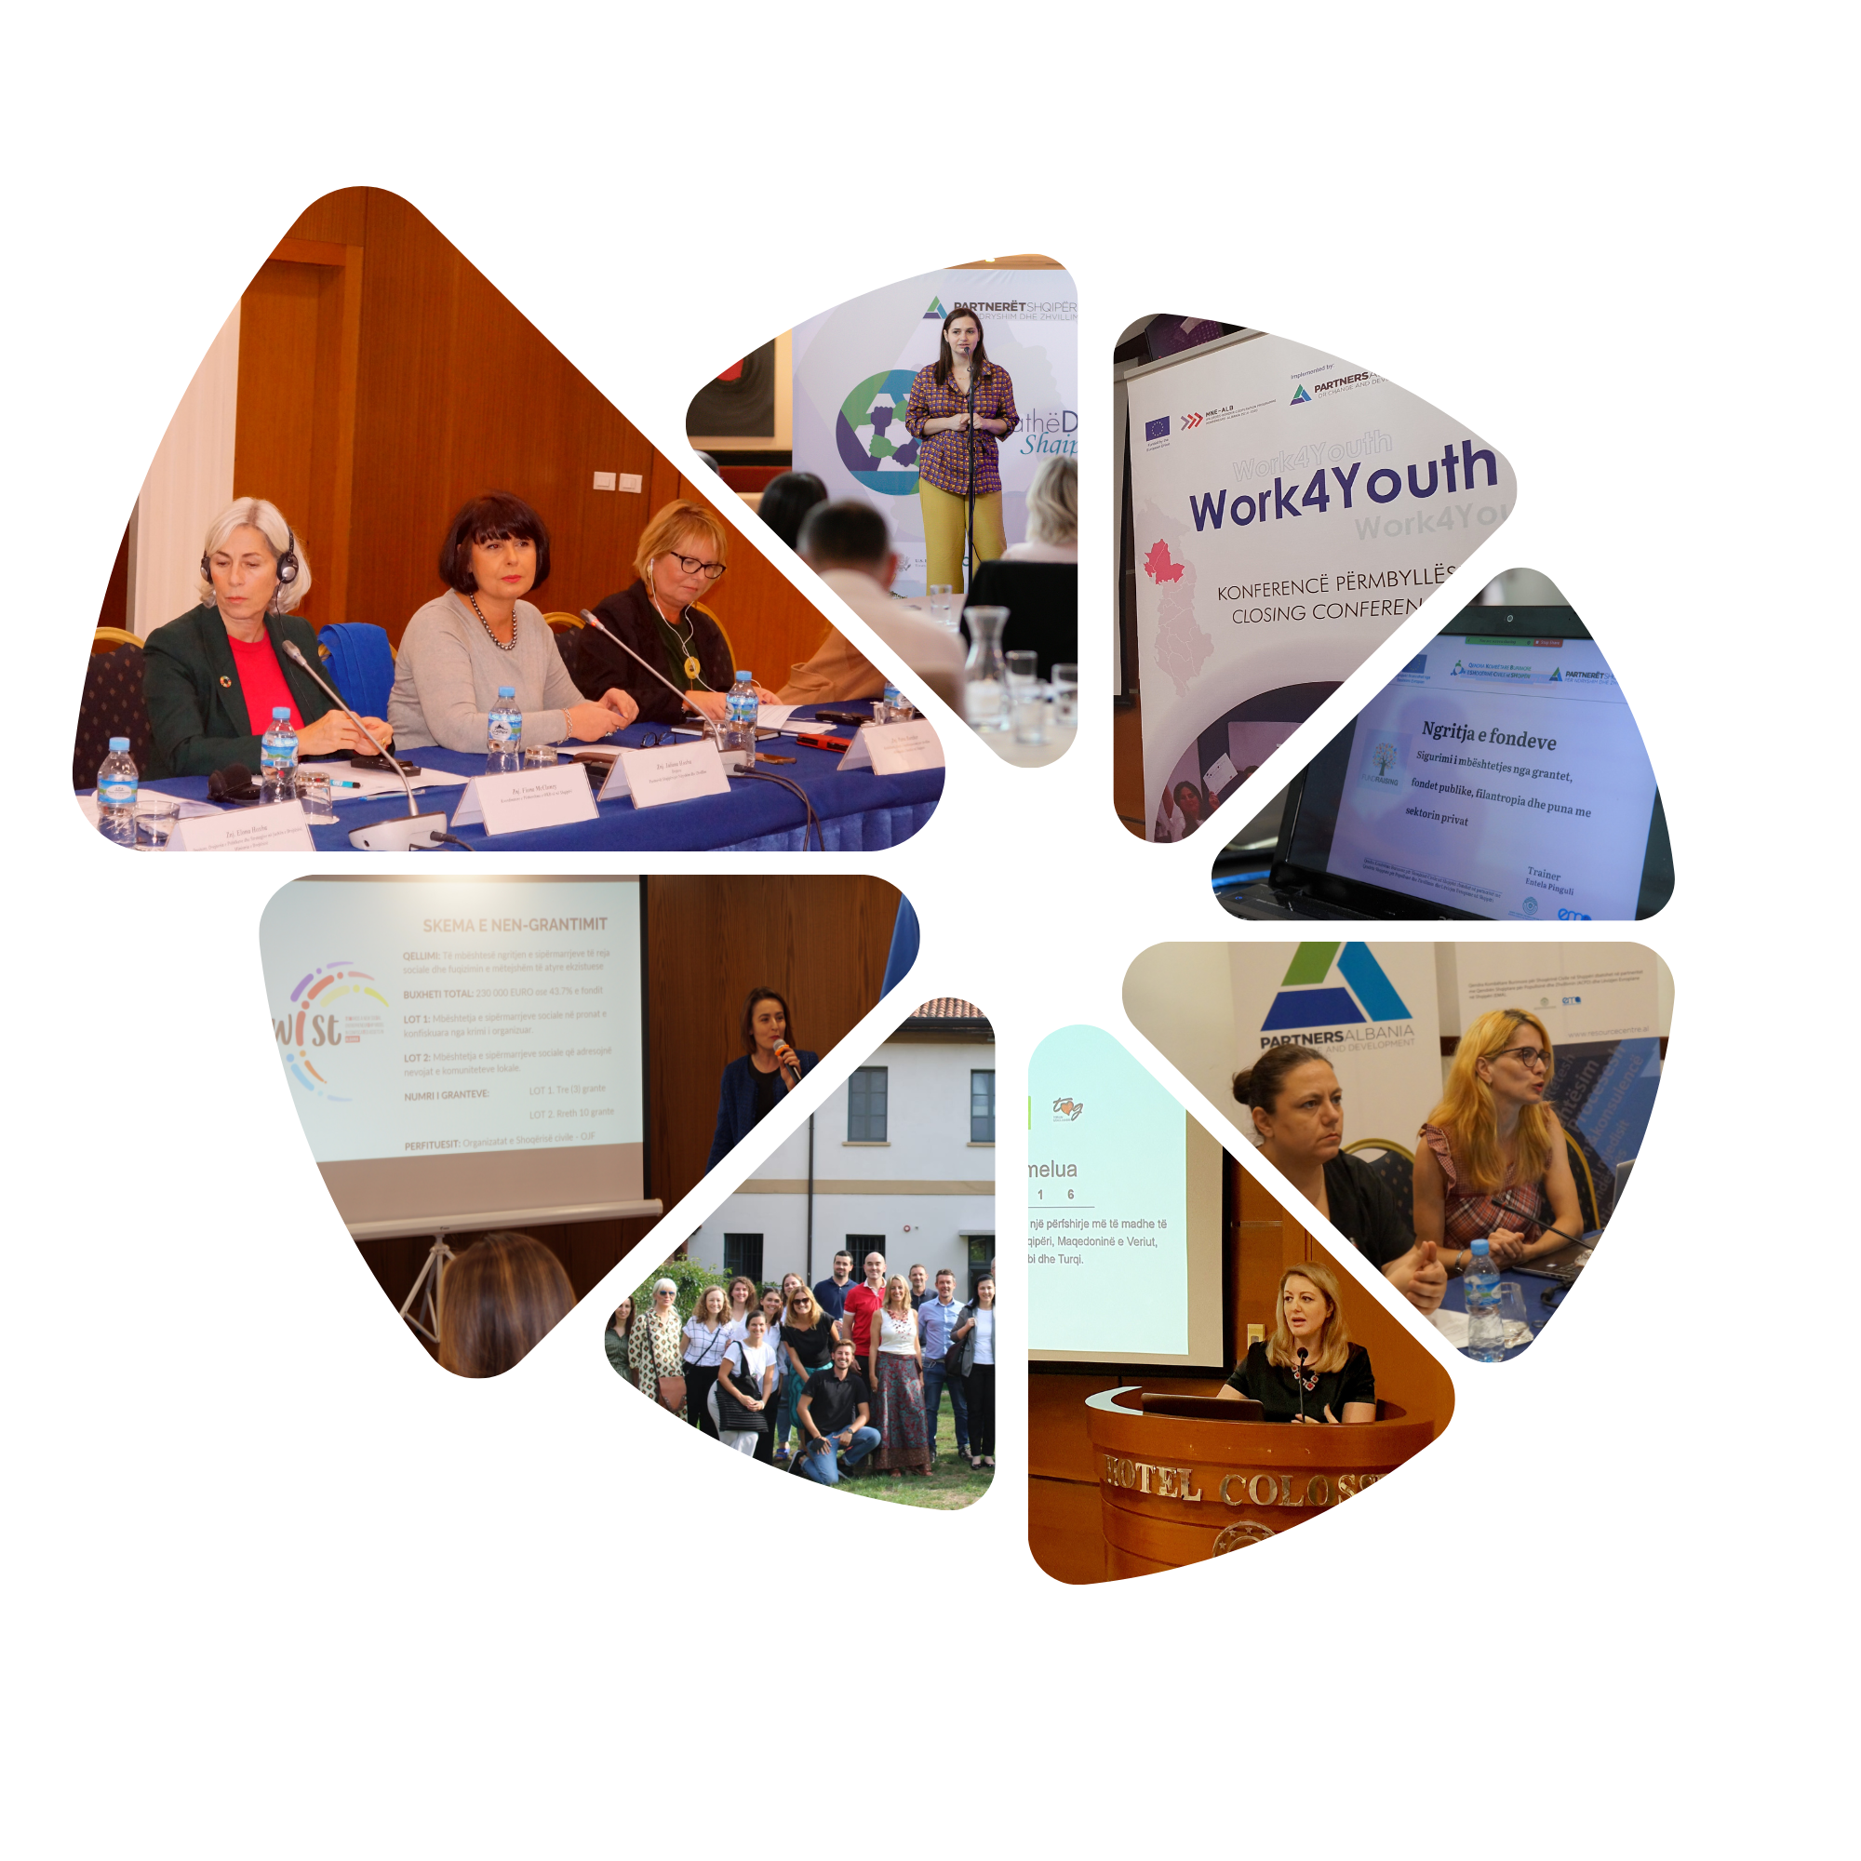
Programmatic areas
Enabling Environment And Sustainable Development Of Civil Society;
Philanthropic Activity And Support Infrastructure;
Transparent And Accountable Participatory Governance;
Entrepreneurship And Social Innovation;
Training and mentoring is one of the key services we provide for the civil society organizations and other partners/stakeholders in all programmatic areas.

Slide 4
PA work in figures since 2001
Since its inception, Partners Albania has played a pivotal role in enhancing the capacities of NPOs through training and mentoring.
Rich curricula (more than 30 topics)
763 training programs delivered
16.071 persons trained
943 persons coached
570 days of coaching sessions

Slide 5

Since 2019, the support for the civil society sector has primarily been directed through the National Resource Center and the range of services it offers.
A platform of services for the sector, funded by European Union.

Slide 6
National Resource Centre for Civil Society in Albania (NRC)
NRC contributes to the development of civil society and the creation of an environment that is conducive to civil society, participatory democracy and the EU integration process in Albania.
The main focus of our work is:
  Enhance CSOs capacity to be professional, credible, effective and accountable independent actors through training, mentoring, awareness and information to CSOs in a wide variety of areas, such as participation to policy-making, cost-effective service provision, fundraising and diversification of funding, communication, transparency, effectiveness, accountability, self-governance.
  Increase collaborating, networking and advocating at local/national level and ensure effective outreach to the state institutions and visibility in media and public at large.

Slide 7
Office in Shkoder
Centre “Trokitje” - ACPD
Address; The congress of Përmet, Str. Oso Kuka, 2nd Floor, Entrance 1, Shkoder
Email: shkodra@resourcecenter.al
Main Office in Tirana
Partners Albania for Development and Change
Address: Elbasan Street, PARK GATE, 10th Floor, Ap. 73,
Tirana
E-mail: info@resourcecenter.al
Office in Vlora
Centre “Aulona” - ACPD
Address: Neighborhood 29th November, Str. Dede Ahmet Amataj,
Mother's Day 15, 2nd Floor, Vlora
E-mail: vlora@resourcecenter.al

Slide 8
NRC regularly conducts yearly need assessment of the civil society organisations.
FEW highlights from the 2023 Need Assessment
What skills are mostly needed by civil society organizations?

Slide 9
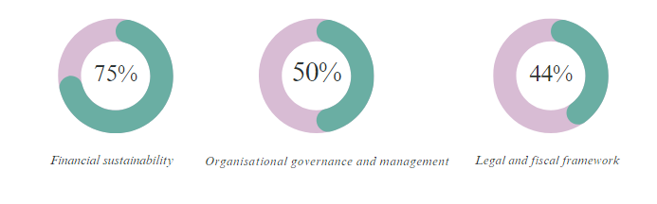
What knowledge and skills are most needed
MAIN
AREAS

Slide 10

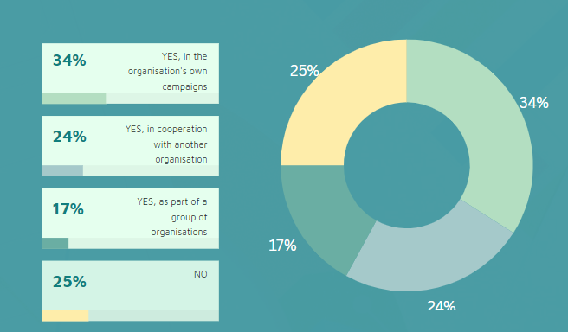

What knowledge and skills are most needed
CSOs engagement in advocacy campaigns in the last two years
59%
Capacity building needs*
*Multiple-choice question

Slide 11
What knowledge and skills are most needed
Assessment of the level of knowledge of CSOs on the EU integration process
CSO information on platforms and structures for integration, created at the inter-institutional level

Slide 12
What knowledge and skills are most needed

Slide 13
Among many capacity building programs, three are the FLAGSHIP that Partners Albania offers from many years now.
NPO Academy
Diversification Of Funding For NPO - CSOs Revenue Generation From Fe-For-Service
Resilience Program for NPOs

Slide 14
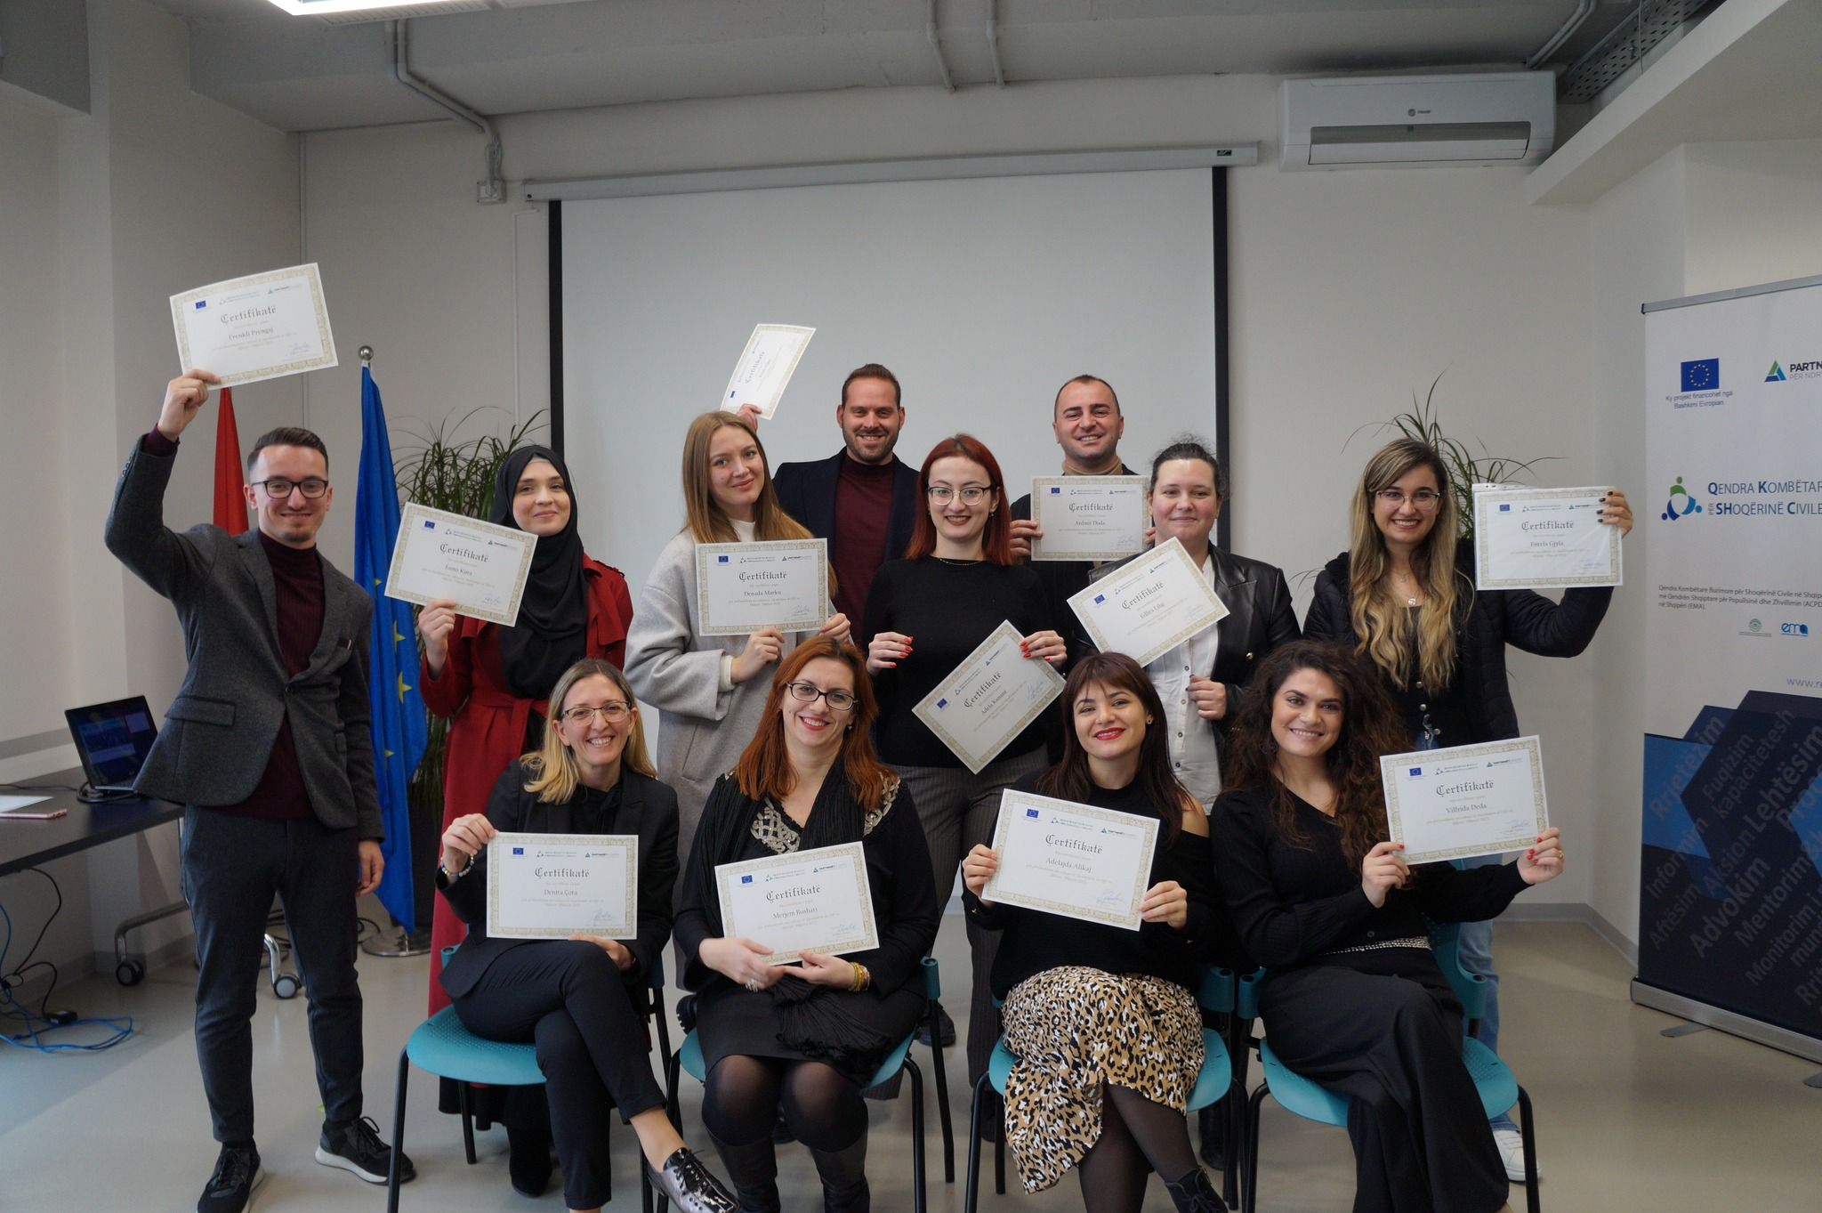
NPO Academy is an annual program, which contributes to enhancement of knowledge and skills of NPO executives and managers regarding organizational development and management, financial sustainability, advocacy for common interest issues, strengthening of inter-sector cooperation etc.
Since 2015, year in which the program was first launched, over 170 representatives of Albanian NPOs, with a wide geographic, sectorial and gender representation coverage, gained knowledge and skills in regard to effective management of their organizations in order to assist their stakeholders and wide public.

Slide 15
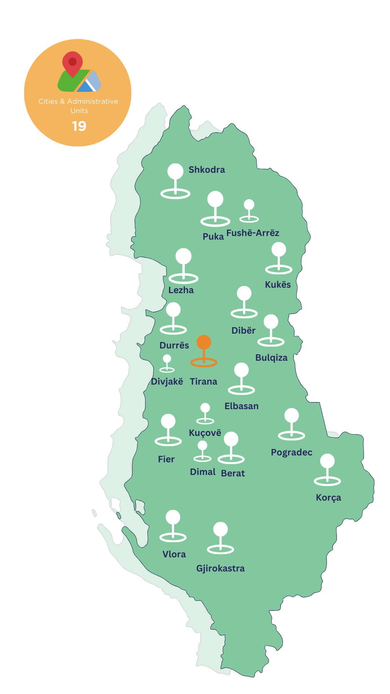
Geographical coverage
NPOs Participation as
per year of establishment
49 % of NPOs established in the last 5 years
71% Tirana
29% Outside the capital

Slide 16
NPO Academy Program main components
On site lectures (1 per 3 weeks)
  Civil society sector trends of development and NPO legal framework
  EU integration process and CSOs role
  Organizational development and governance, human resources management and internal procedures
  Financial management: Budgeting and accounting; Reporting to state authorities
  Ensuring public support and working with the private sector. Fundraising and philanthropy
  Ensuring financial support through grants. Proposal writing and project management, EU grants
  Strategic communication for NPOs
  Strategic planning
  Participatory governance
  Mobilization of constituencies. Networking and coalition building
  Advocacy and Lobbying

Slide 17
NPO Academy Program main components
Resource materials and assignments regarding development of new / improved internal policies and procedures, financial formats, proposal formats and fundraising plans, communication tools etc.
Individual coaching and mentoring sessions according to participants needs in order to guarantee the implementation of the gained knowledge and competences during the Academy to respond to the needs of their organizations.
Enhanced networking and cooperation among CSOs (alumni group)
Participation in study visits to CSOs, donors community, government institutions, and businesses- introducing to success practices, share experience and good models of NPO-Government cooperation, NPO-private sector, participatory processes, crowd sourcing, found raising etc.

Slide 18
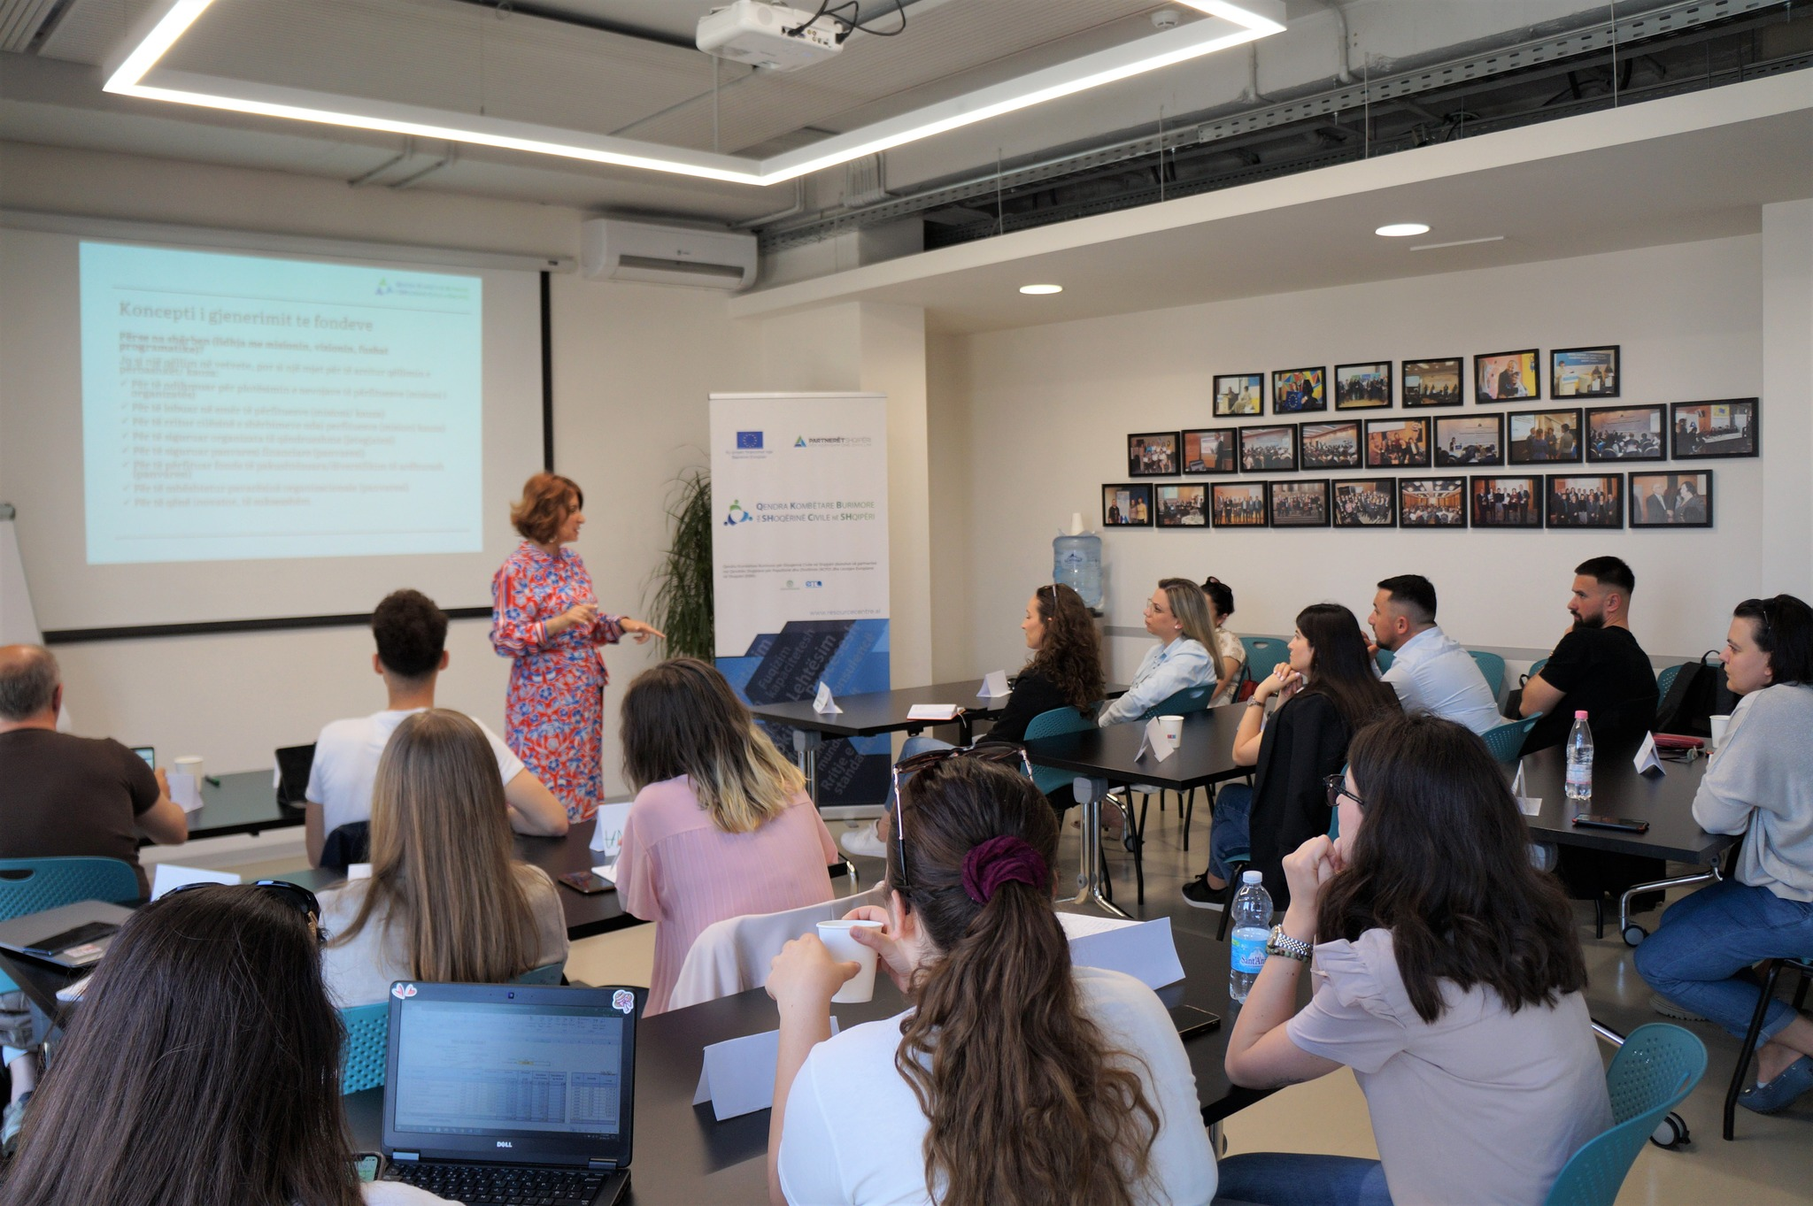
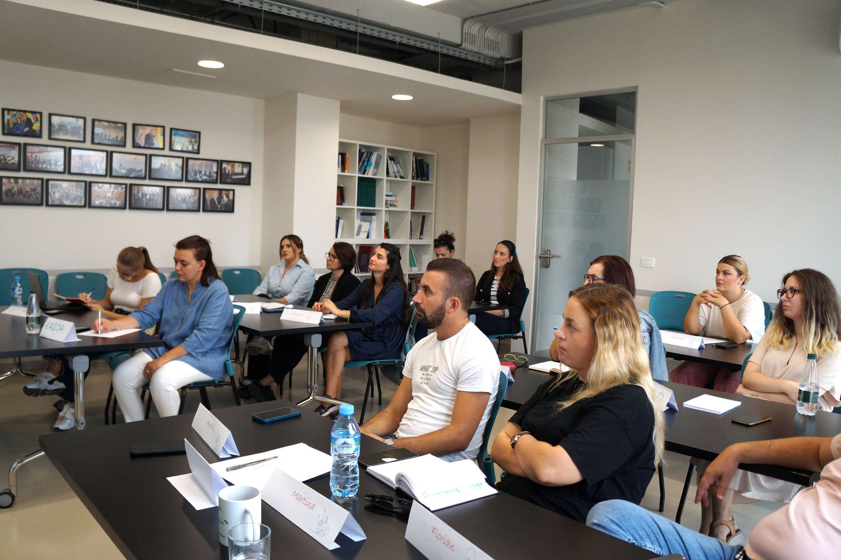
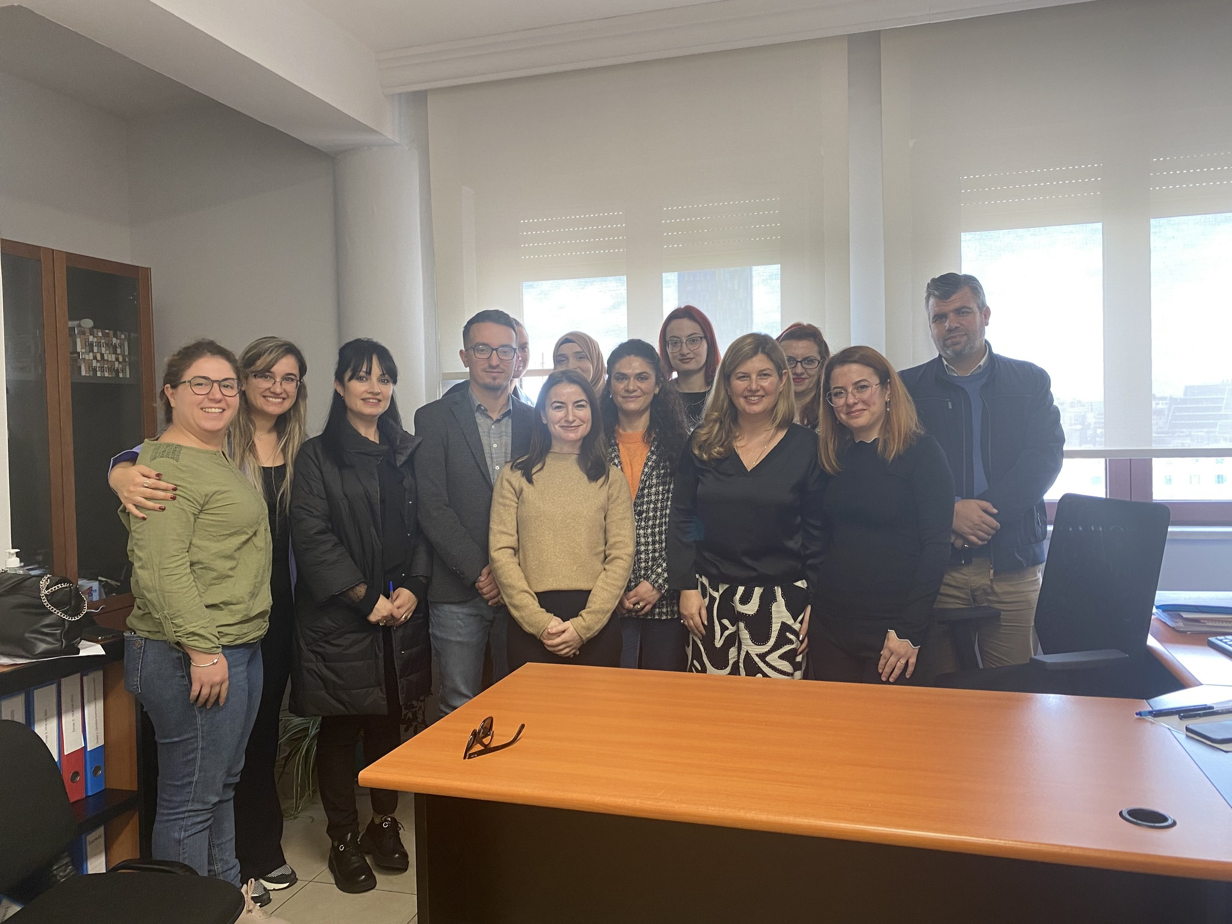
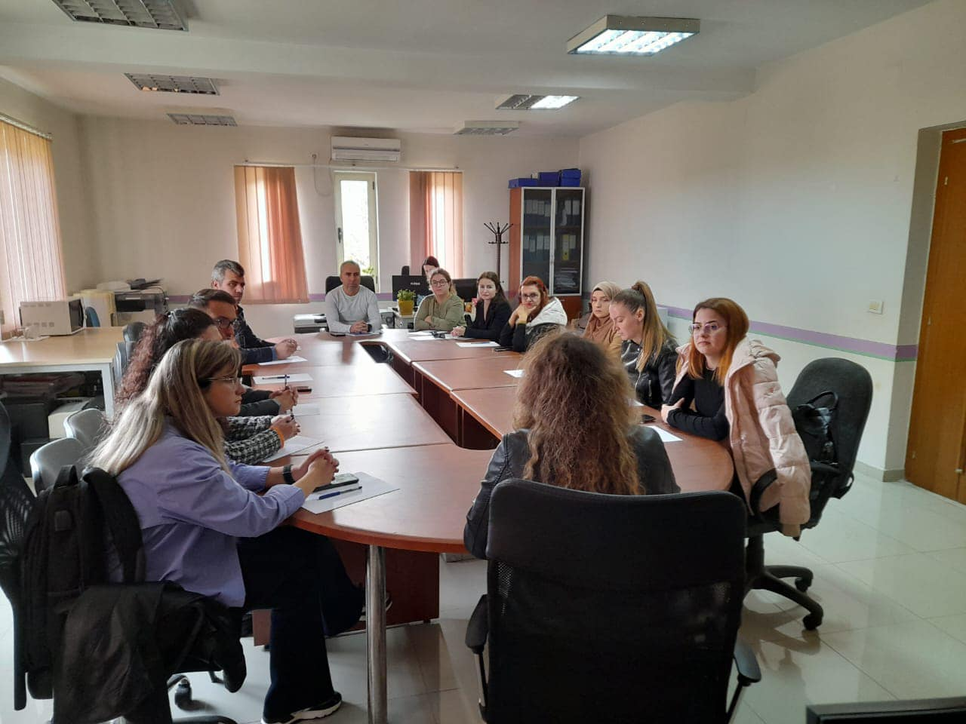
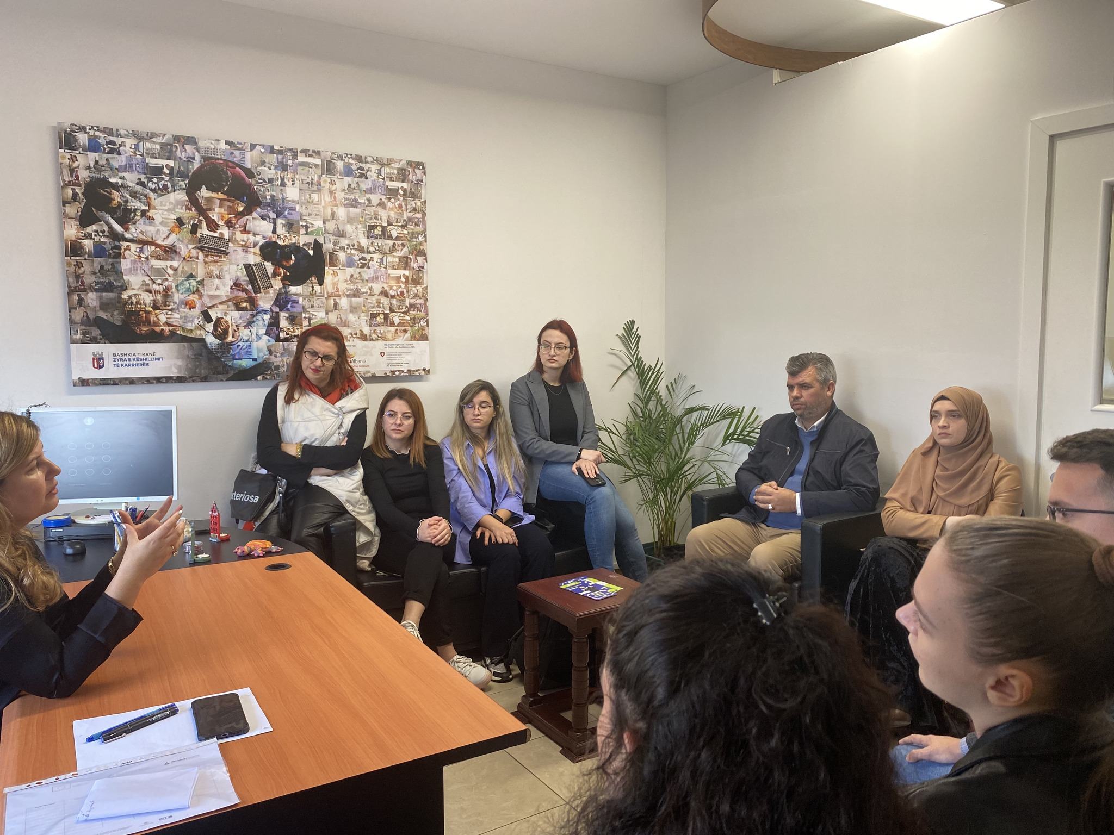
NPO Academy

Slide 19

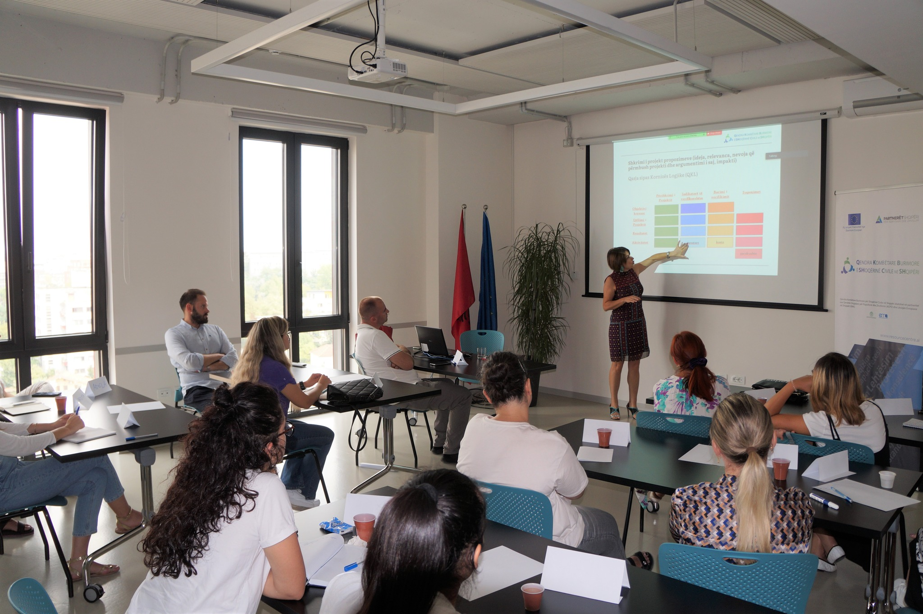
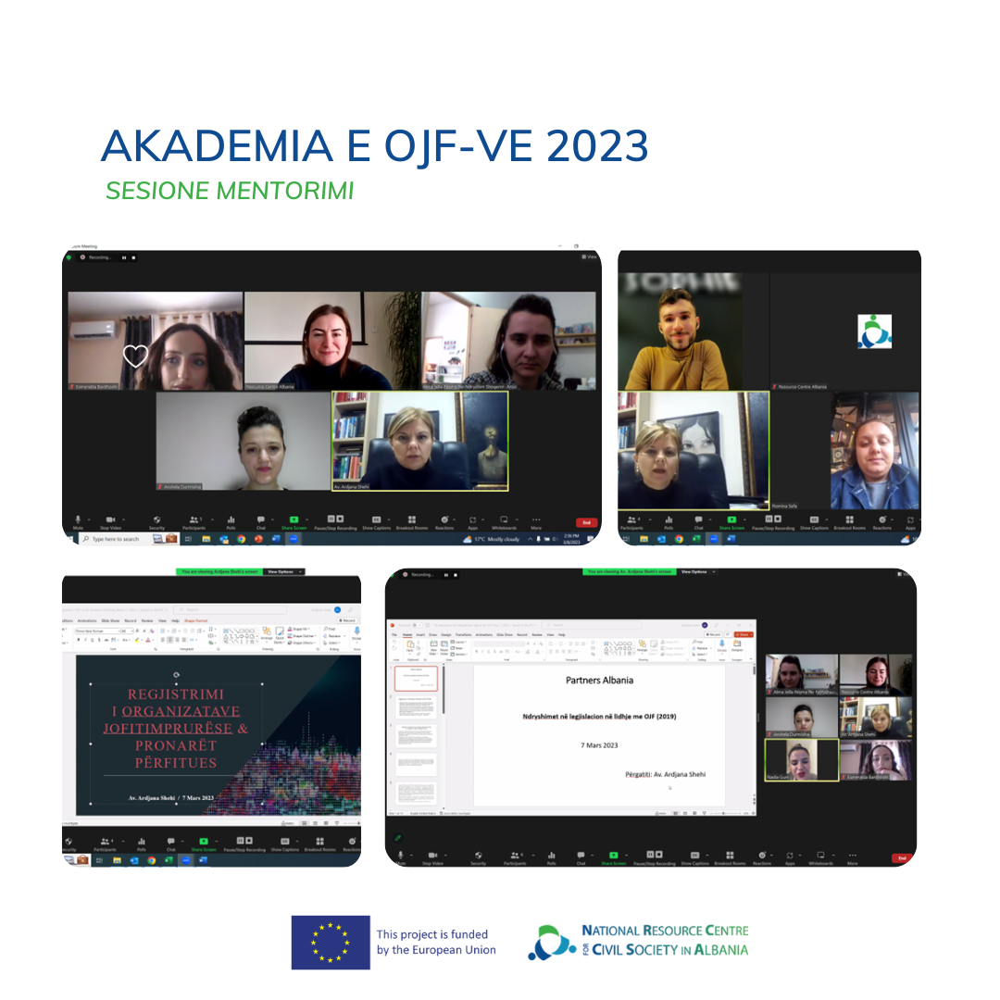
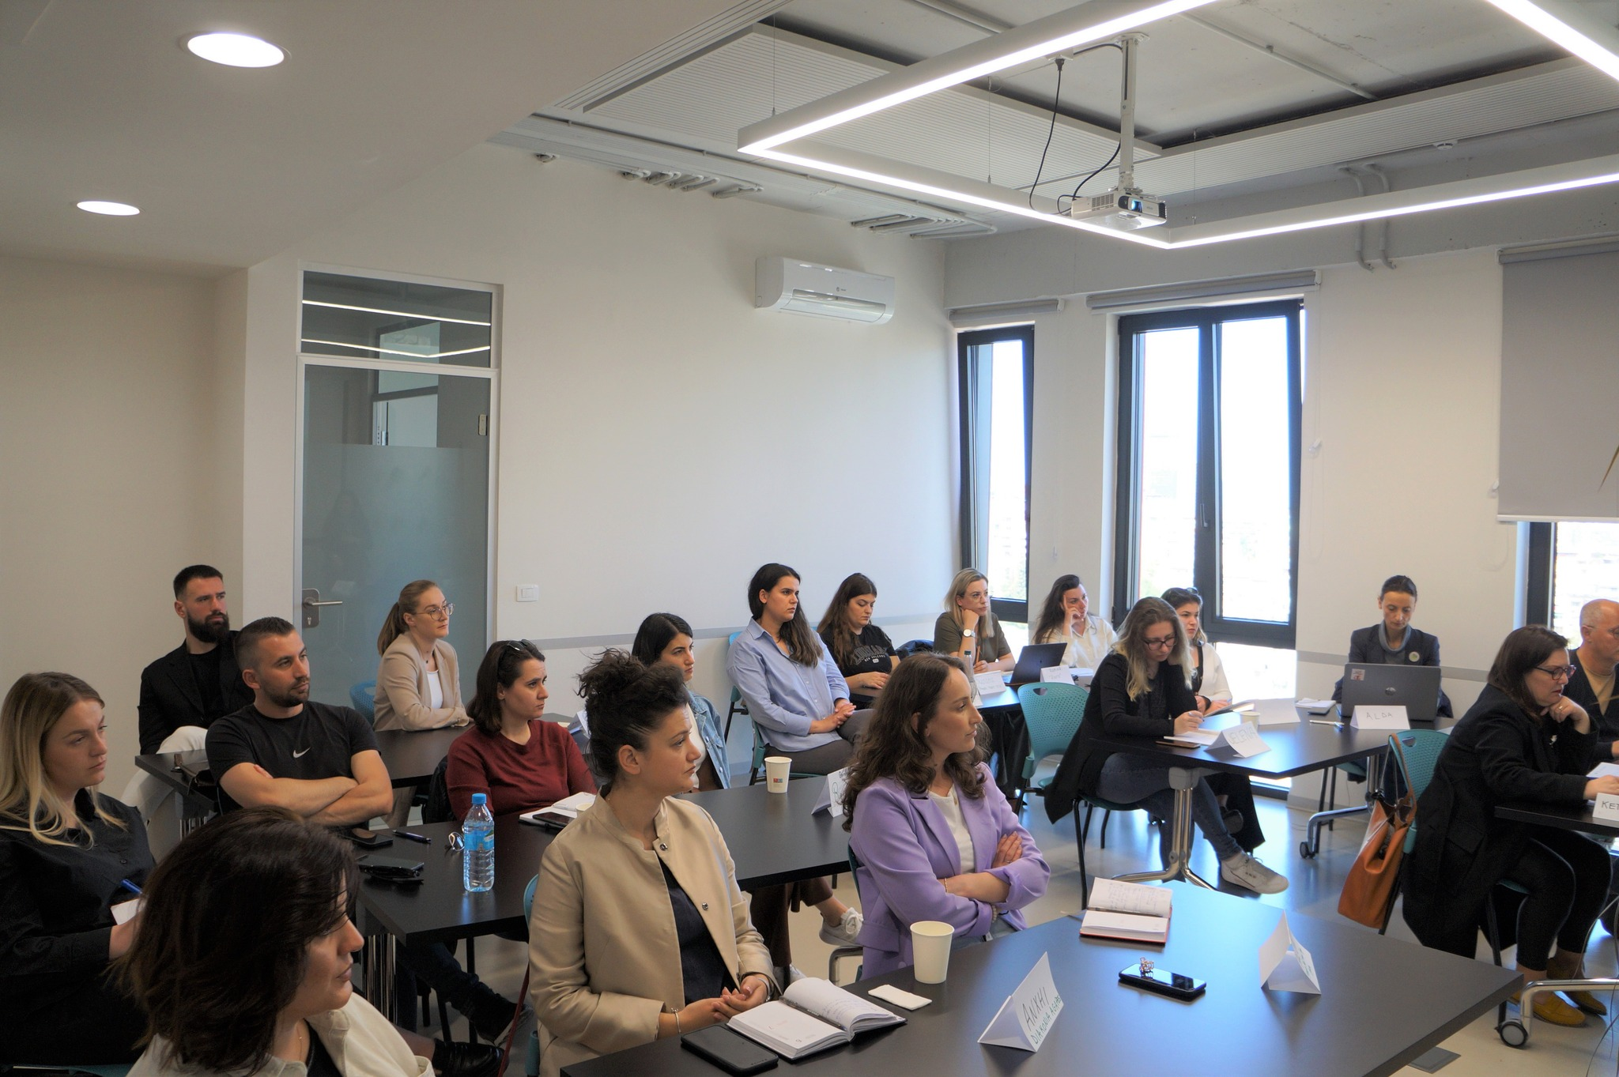
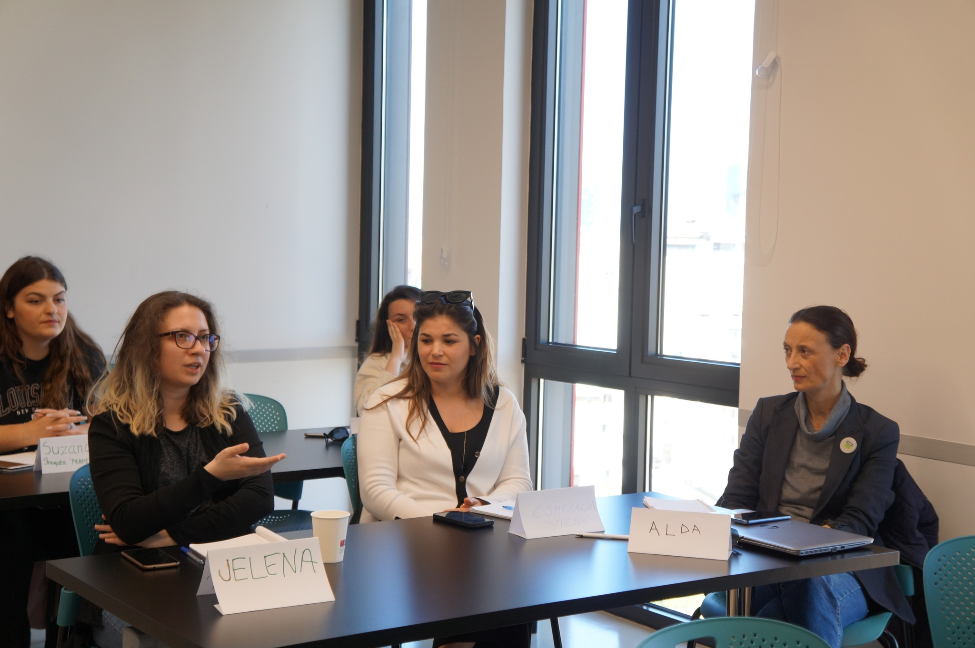
NPO Academy

Slide 20
IMPACT on SEVERAL LEVELS
Help employees acquire and enhance new skills, related to project management, fundraising, program development, communication, etc.
Improve staff performance (well-trained and mentored staff, perform their duties more efficiently and effectively).
Provide opportunities for staff members to network, share experiences, and build collaborations
Equips them with the skills needed to secure funding and support for the organization's mission
Contribute to the overall effectiveness and sustainability of the organisations.

Slide 21


Thank you!
partners@partnersalbania.org info@resourcecentre.al
https://partnersalbania.org/
https://resourcecentre.al/

