Slide 1








Skills & the Nonprofit Sector

Slide 2

Introducing The Wheel
2,320 Members across civil society in Ireland: charities, community organisations, voluntary service providers, cooperatives, social enterprises, NGOs...
28.9% of the turnover of the entire sector (€4.1 billion of €14.3 billion) is represented in our membership*
35.2% of all employees in the sector are represented in our membership*
*Source: Benefacts Benchmark Report

Slide 3
The Wheel is committed to ensuring that Ireland’s 500,000 nonprofit workers, both paid and unpaid, and the organisations they work in, have the skills they need to deliver their varied and important missions across Irish society.

Slide 4
Skills & The Nonprofit Sector
Vital Workforce
Partner in Social Change
Advocate of lifelong learning
Civil Society’s Role

Slide 5

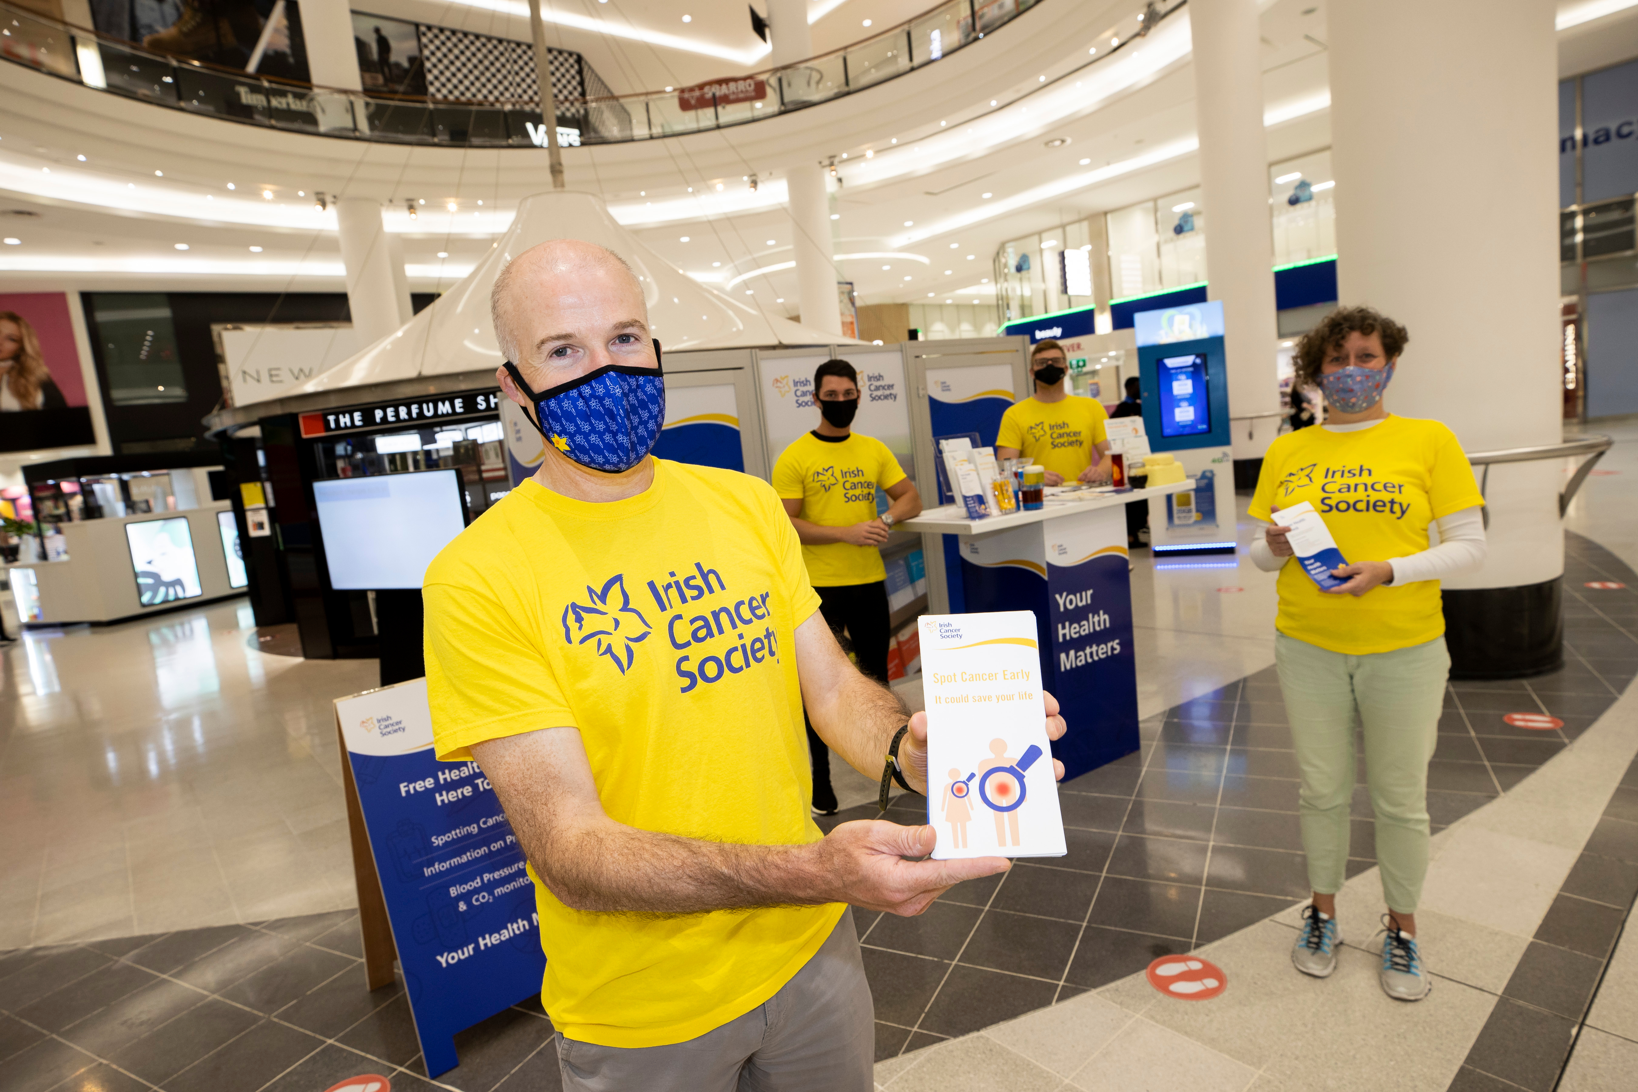
Irish Civil Society workforce profile

Slide 6
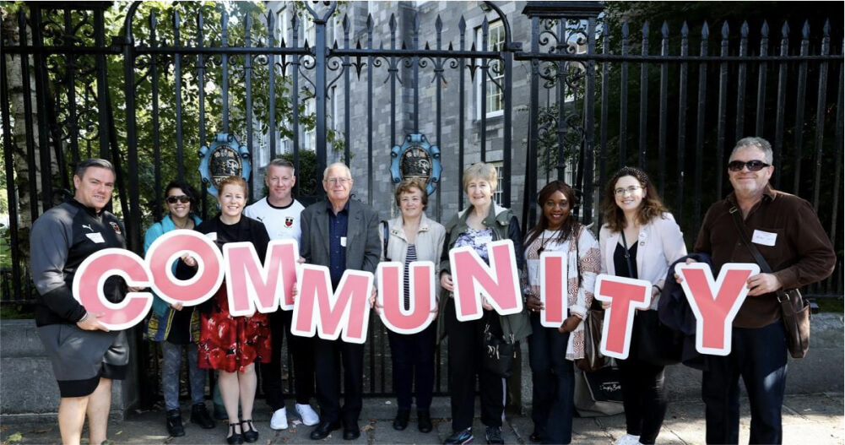
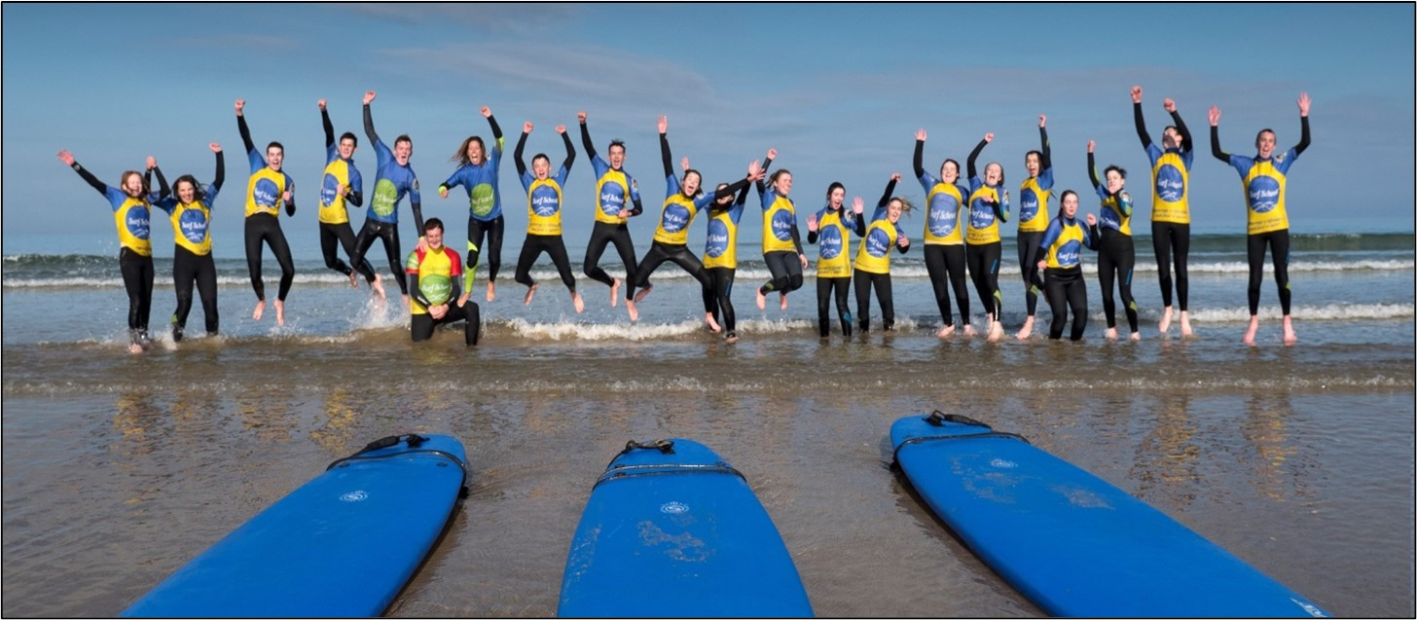
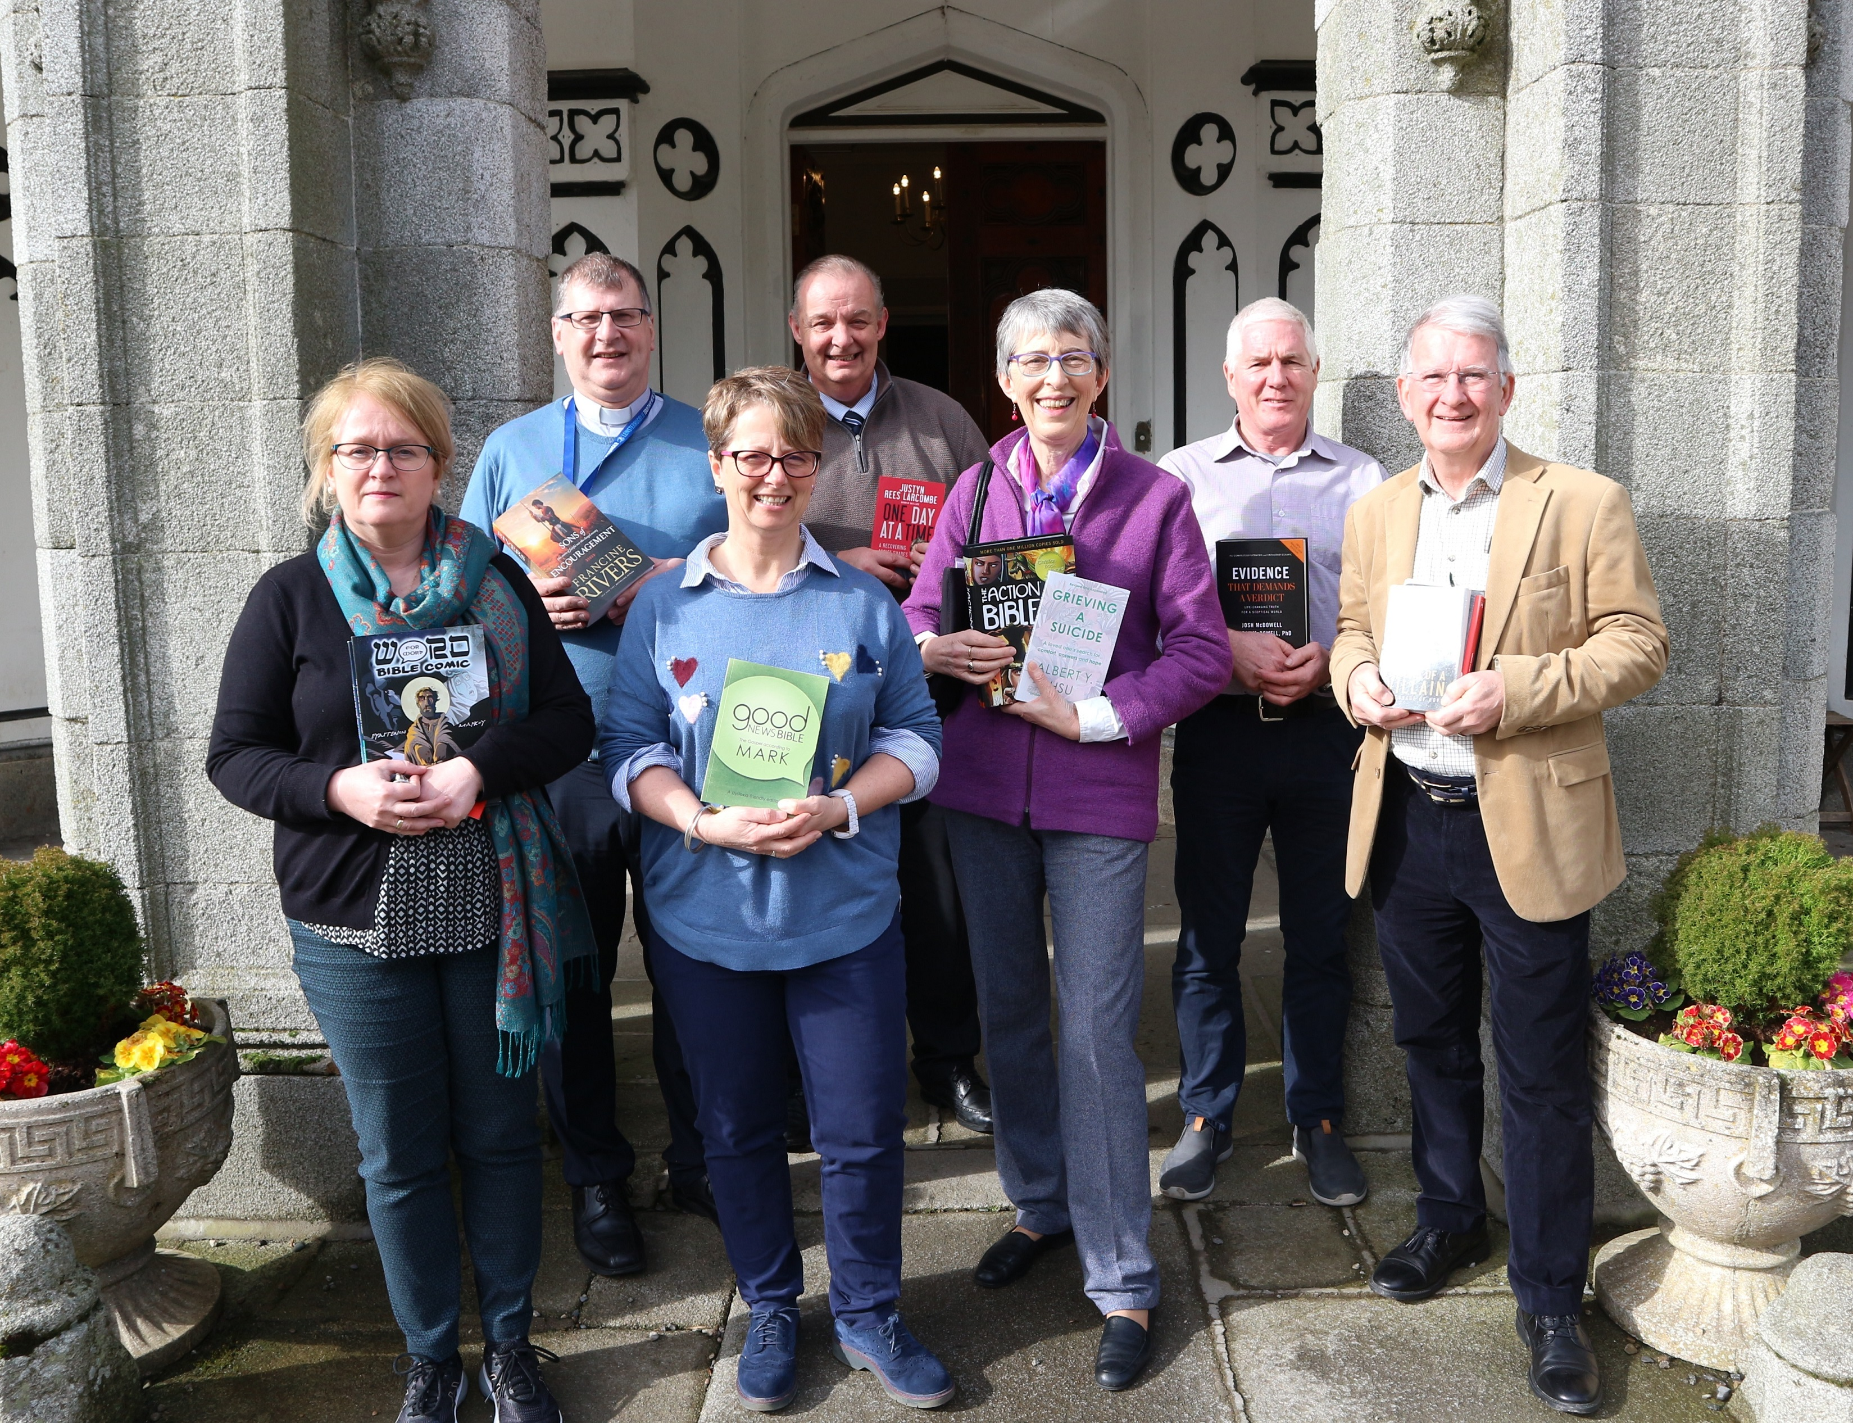
A Vital Sector
circa 33,000 organisations
170,000+ employees
300,000+ volunteers
income of €14.2 billion per year
1 in 3 people delivering public services works in a civil society organisation

Slide 7
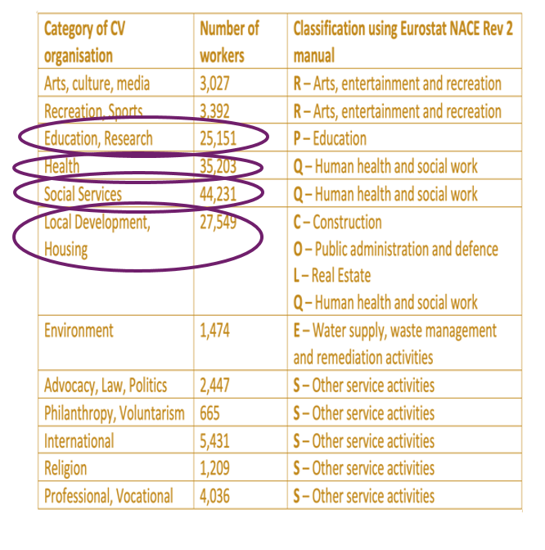
Civil Society Workforce Skills Profile
Similar workforce to the public sector
(“Q” and “P” NACE classifications)
Very different from commercial SMEs
(“B” to “M” NACE classifications)
Unique features and context, incl.
Governance, Regulation, Reporting, Impact Measurement, Income diversification, Working with Volunteers and “Scheme” Workers, Involving Communities, Cooperation with Public Agencies…
A Vital & Unique Workforce
Workforce by NACE Classifications
NACE (Nomenclature of Economic Activities) is the European statistical classification of economic activities. NACE groups organizations according to their business activities.

Slide 8

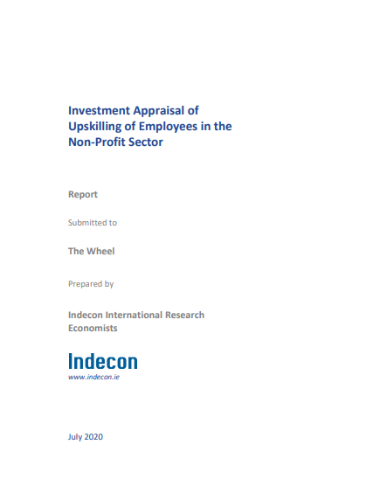
Indecon: Investment appraisal of upskilling employees in the nonprofit sector
Research
Sheila Cahill Consulting: Consultation report on The support needs of the Nonprofit sector

Slide 9
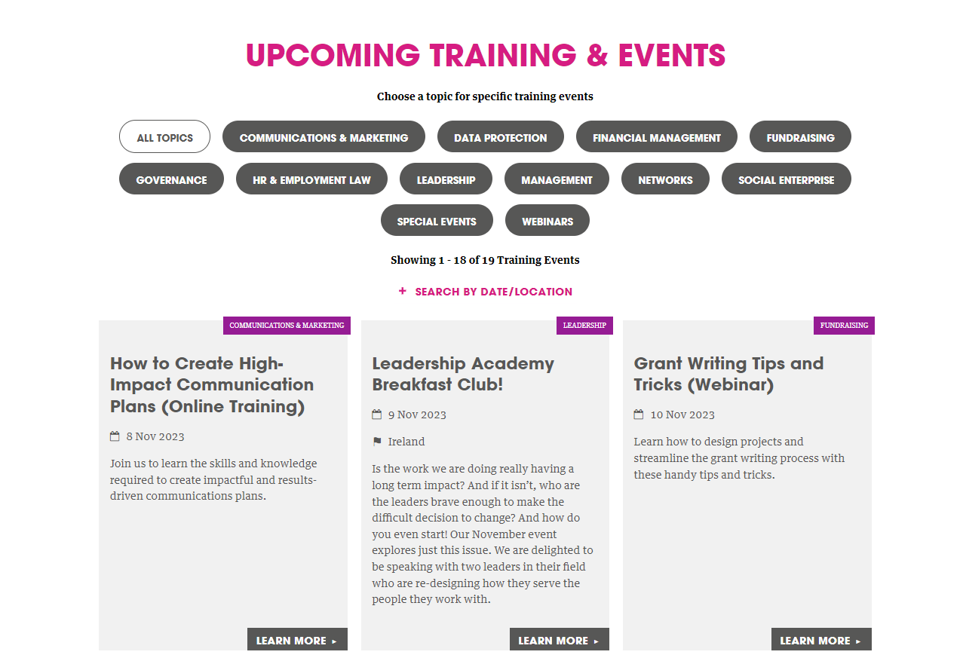
Training Delivery

Slide 10

Leadership Development

Slide 11





Partnership

Slide 12

OECD Review of IreLand’s National Skills Strategy 2025

Slide 13
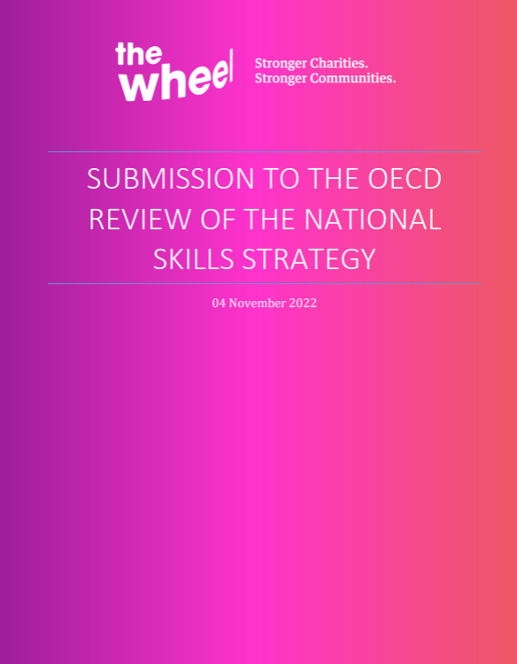
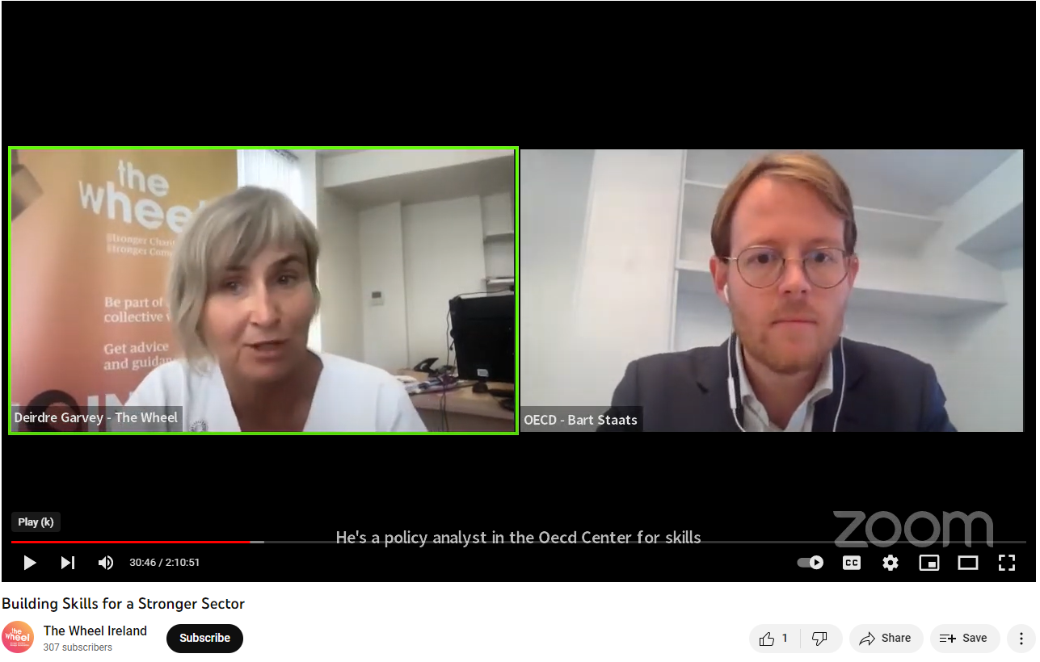
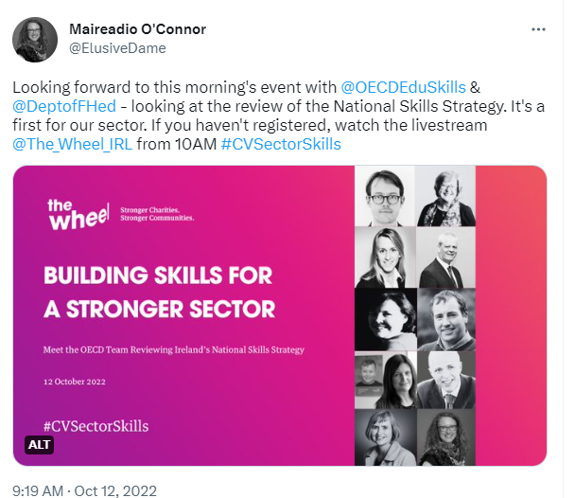
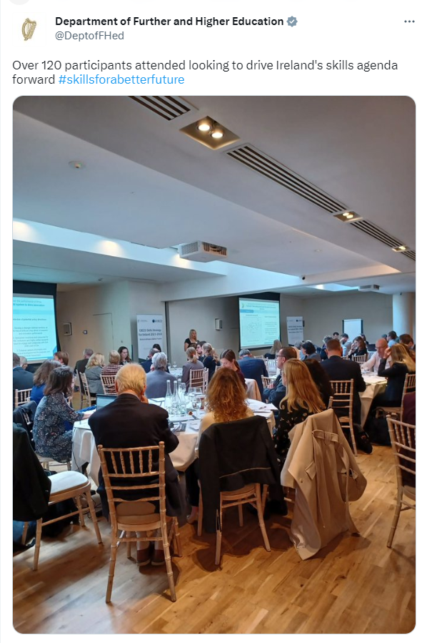
The process

Slide 14

What WE Learned

Slide 15
Skills & the Nonoprofit Sector
A vital workforce
Already working with communities, especially communities that policy makers find it difficult to reach
Vast experience and diverse expertise across CSOs
We see the results of policy on the ground and are crucial in communicating this to policy makers
Why we MUST involve civil society in this important agenda

Slide 16





