Slide 1

DIGITAL TOOLS FOR PROMOTING THE RULE OF LAW
North Macedonia case
GERMAN FILKOV
31 May 2023
Podgorica, Montenegro

Slide 2
What is important?
To differ:
DIGITIZATION – computerizing, converting analog into digital
DIGITALIZATION – using what’s digital and technology
DIGITAL TRANSFORMATION – doing enabled by digitalization
… and we have problems with all three stages/processes.
Notes:
Digitization – files and data, or from paper to digital; Digitalization – using what was transferred into digital for work, processes, etc. Digital transformation – utilizing or leveraging digitalization. Problems – we are here to talk about transformation or using digitalization for common good, for enabling environment for us, for rule of law, etc. but we’re still having issues with the foundation or digitization and with digitalization. My point here is that we need to push for all these three processes.

Slide 3
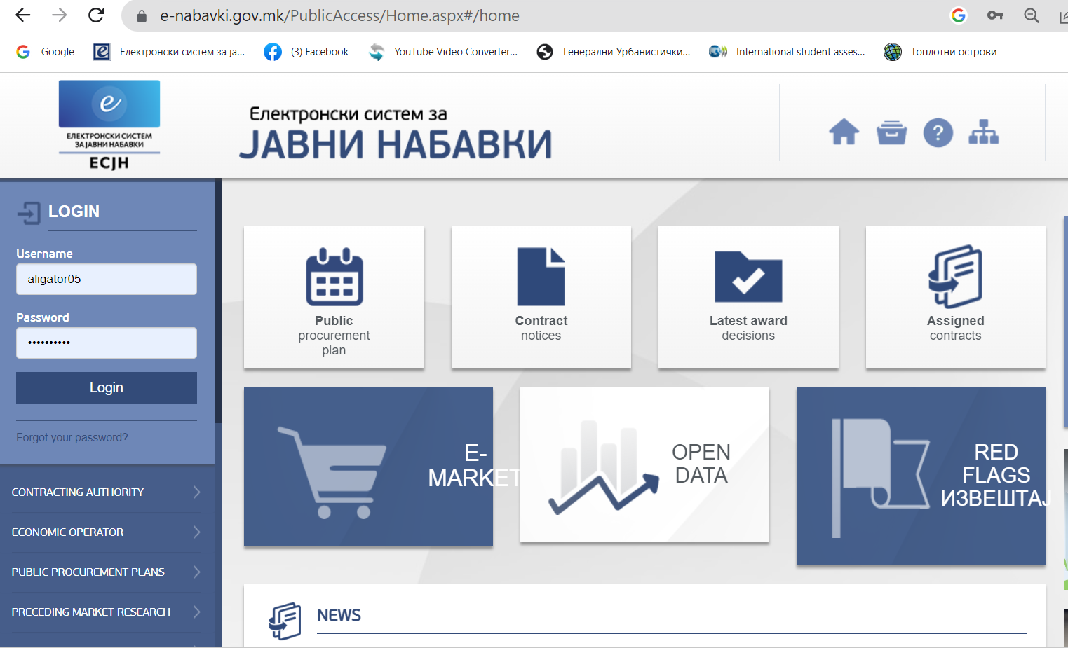
e-PROCUREMENT
WHAT’S AVAILABLE:
Tender notice
Tender documents
Contract notice
Decisions
PP plans
Contracts and annexes
Connected to websites
Open data
E-complaints
Bidders
Red flags
Open format
All the rest vie FOIA
…
Notes:
I choose today to present you two digital tools whose building and constant improvement was initiated or fostered by civil society and later used again by civil society and the media for enforcing rule of law in the country. First is e-procurement platform – a completely electronic platform for conducting public tenders – once established – constantly being updating with more and more data available online for usage of civil society and the media – number of corruption cases being discovered as a result – Rashkovski, Nadzor avtopati

Slide 4
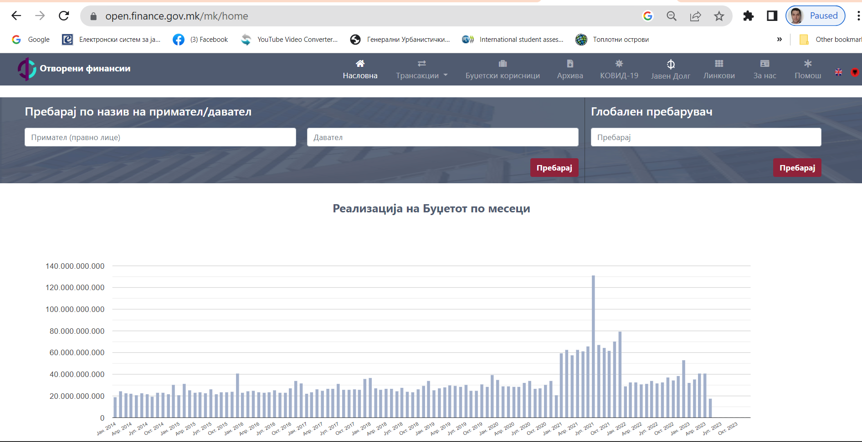
A case study: Open Finance
Notes:
All budget transactions done through the state treasury, data have been updating twice a month, searchable and downloadable in an open data format. Once being discovered by the media, the Government cut on advisors and advisory services.

Slide 5
A case study: Open Finance
2013
2017
2018
Mid 2019
Noe 2019
Idea
Came from civil society
Acceptance
Accepted by the MoF and promoted as his own idea
Push forward
Envisaged in OGP’s National Action Plan 2018-2020
Funding
Realization
Function
No one wanted to accept
Foreign donors prepare project and secured fundings
FOI law was amended to provide legal ground
The platform became fully operational
(I stage)

Slide 6
What’s missing?
Some are still NOT DIGITIZED
  (State property)
Most are DIGITAL, BUT NOT DIGITALIZED
  (MOI, Public administration)
Some are DIGITALIZED, BUT NOT PUBLICLY AVAILABLE
  (State Cadaster, Central Registry)
NO DIGITAL TRANSFORMATION, yet
  (No interconnectivity, no interoperability, no blockchains, etc.)

Slide 7
DIGITAL TOOLS FOR PROMOTING THE RULE OF LAW
North Macedonia case
GERMAN FILKOV
31 May 2023
Podgorica, Montenegro

