Slide 1


Slide 2




CONNECT International is an international Brussels-based network formed to serve as a connection point among different stakeholders working with digital rights and digital agenda.

Slide 3


The mission of CONNECT International is to design innovative European projects ensuring mainstreaming of digital rights and digital agenda with young people and other citizens.
The vision of CONNECT International is bringing humanity to digital life.

Slide 4


Slide 5




CONNECT International brings together individuals and organizations focused on its 4 pillars of work:
CITIZENSHIP
RIGHTS
ACCESS
INNOVATION

Slide 6





Since the online dimension became an integral part of people’s identity, we believe that protection of rights and ensuring the safety of virtual environment is equally important as ensuring the same in the real world.
RIGHTS
PROJECTS:

Slide 7






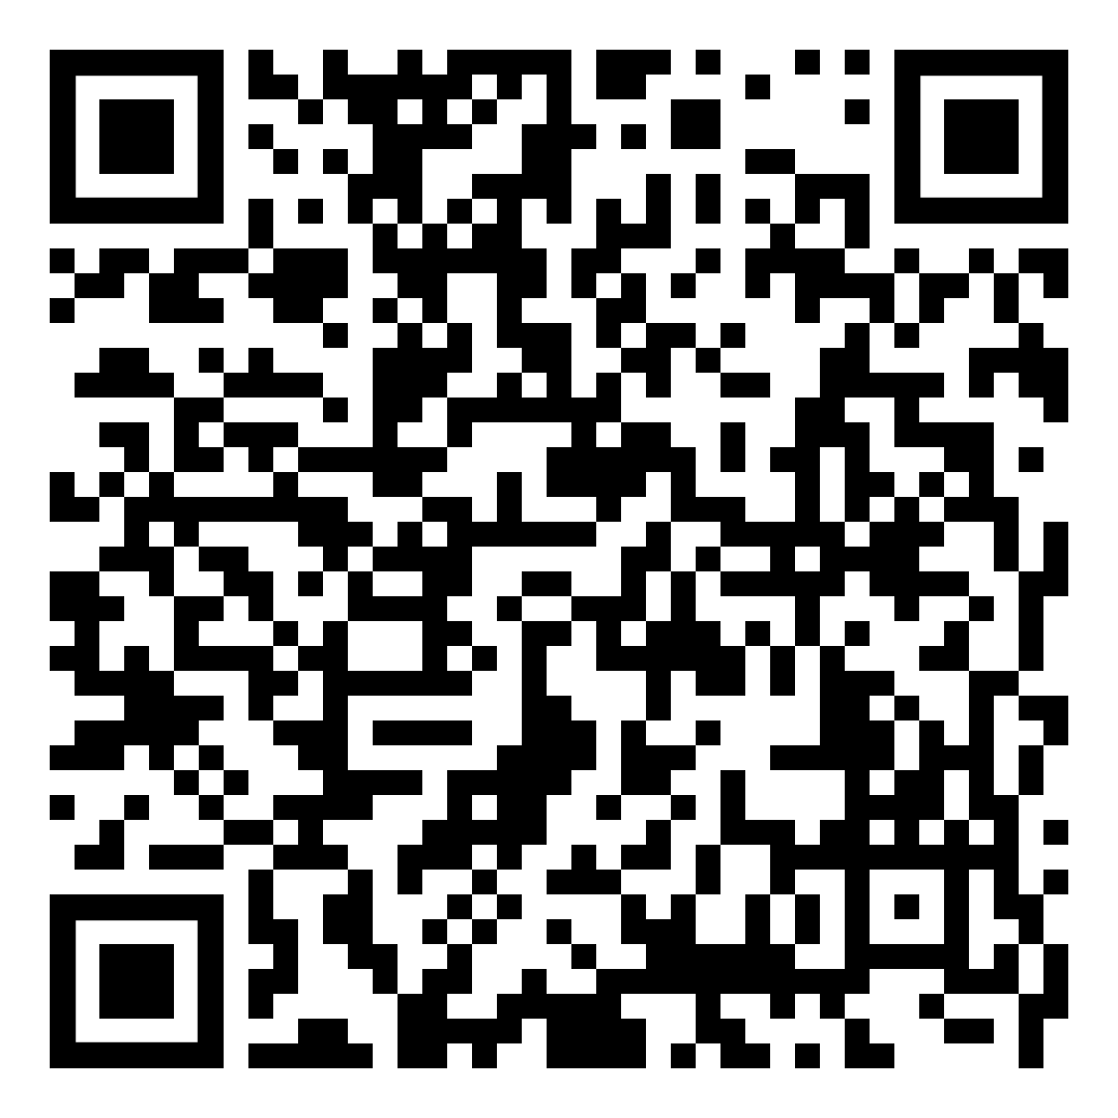

Fighting for strengthening of democratic values and empowering a system of checks and balances in our societies by using digital tools to improve the efficiency of democracy and democratic institutions, strengthen decision making processes and empower youth participation.
CITIZENSHIP
PROJECTS:

Slide 8
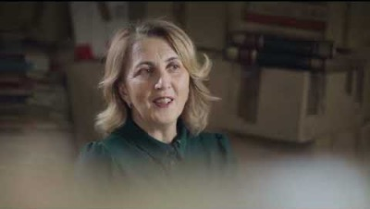


Slide 9






Supporting free and open access to the Internet and improving digital literacy as keys to the personal, social and economic development of young individuals and societies in the XXI century.
ACCESS
PROJECTS:
2.0

Slide 10






We are actively engaged in supporting innovative practices, ideas and ICT development of young people and tools, especially when it comes to utilizing digital tools in youth work.
INNOVATION
PROJECTS:

Slide 11



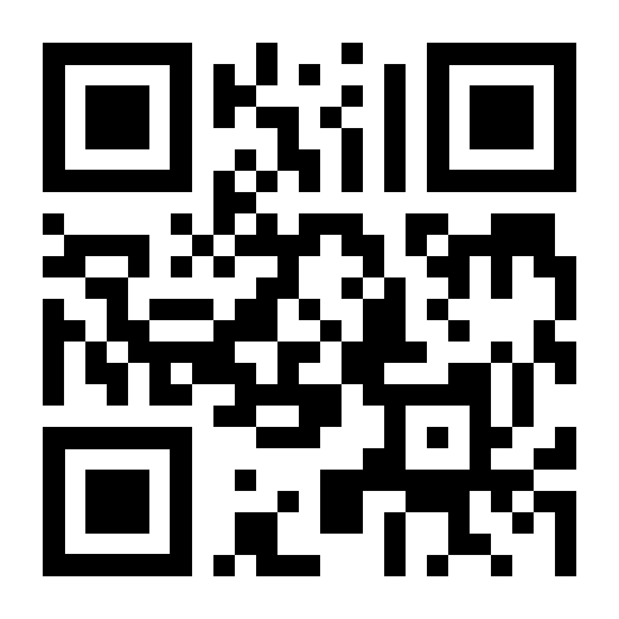
The project Turning Digital is implemented with the ambition to establish a sustainable adult e-learning system that will support adult educators in transferring their work online, while also enabling learners to access professional competencies necessary for participation in the labor market.
Free e-learning platform for raising the quality of adult e-learning is developed and made accessible to all at TURNINGDIGITAL.NET

Slide 12




GET IN TOUCH WITH US
WWW.CONNECT-INTERNATIONAL.ORG
OFFICE@CONNECT-INTERNATIONAL.ORG
www.facebook.com/CONNECT.INGO
www.instagram.com/CONNECT_INTERNATIONAL

Slide 13
Thank you for
your attention!

