Slide 1


(Self)Governance for CSOs in Turkey
1 June 2023,
Podgorica

Slide 2

Slides of the day
A brief introduction of civil society in Turkey – 12 slides
A very brief introduction of STGM - 4 slides
Overview of CSO Governance Initiative – 15 slides

Slide 3
Landscape- Civil Organisations in Turkey
Associations - 102,785
Foundations - 5,655
Unions - 57
Cooperatives- 79.486
Professional organisations - Chambers 4.749
There is no legal framework that unifies non-profit/voluntary organisations

Slide 4
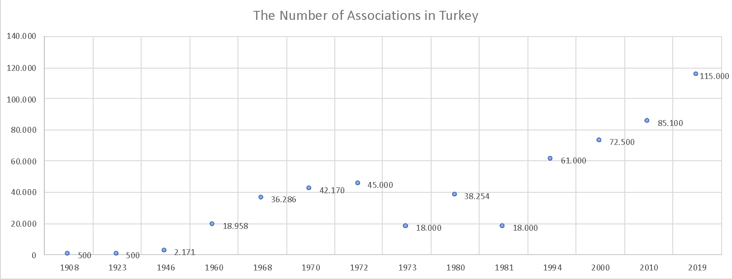
The Number of Associations in Turkey
The last year net loss: 20,000
2020: 121,115
2021: 120,966
2022: 120,696
2023: 101,533
military coup
military coup

Slide 5
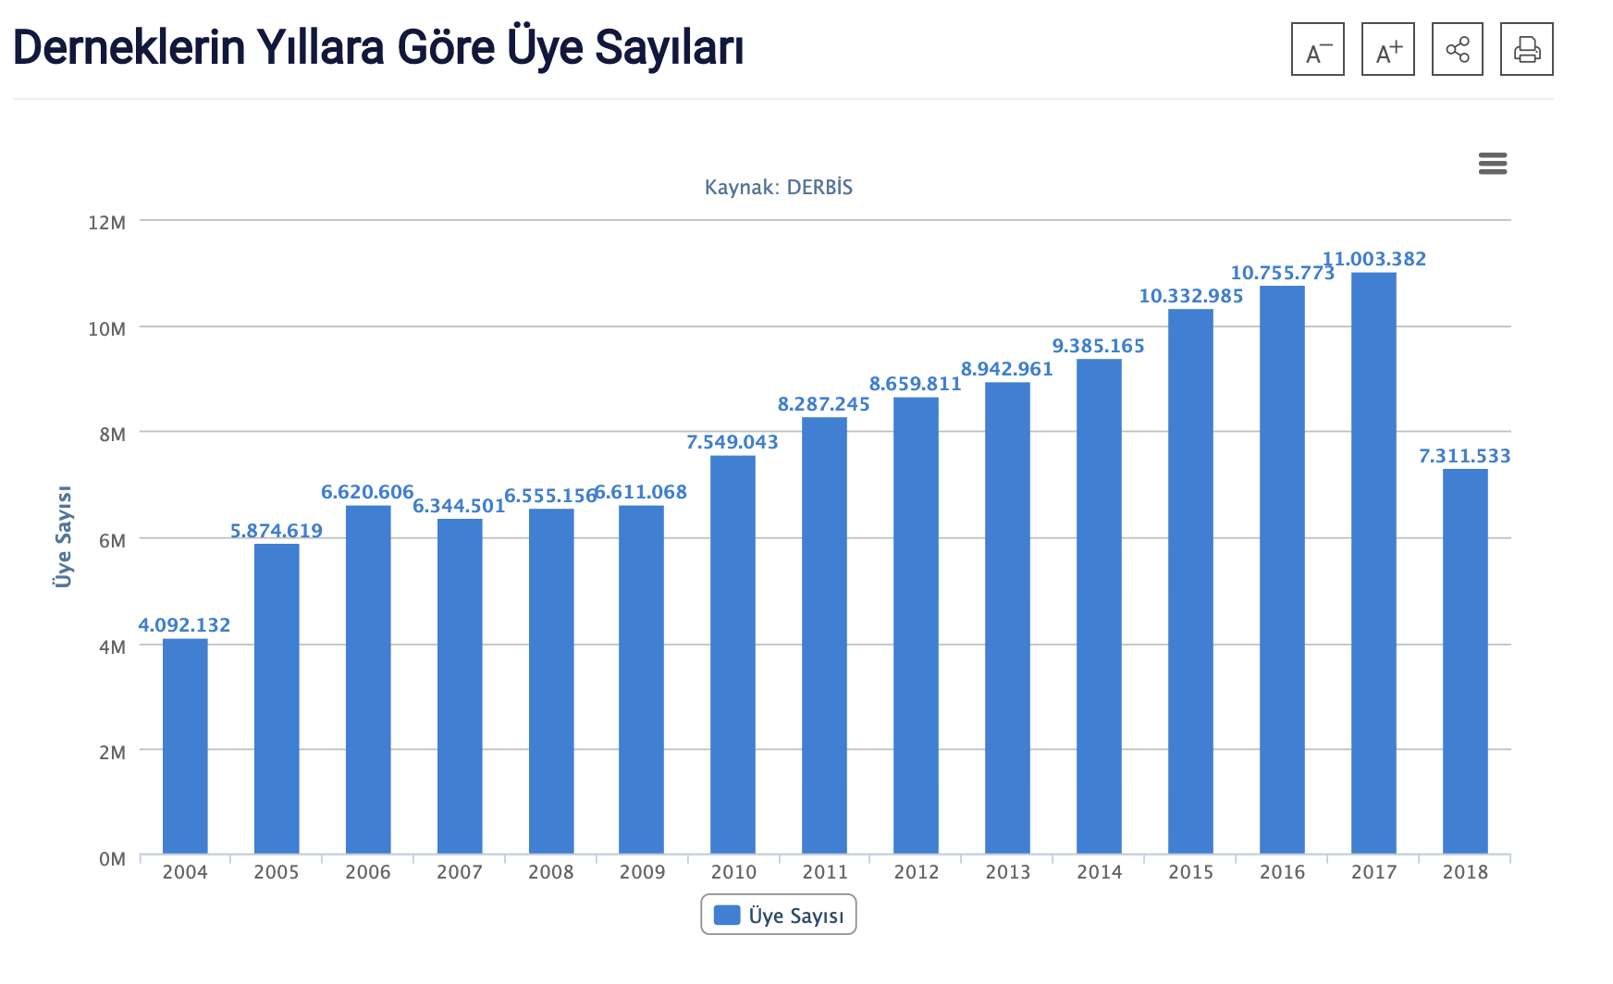
Total Number of Association members

Slide 6
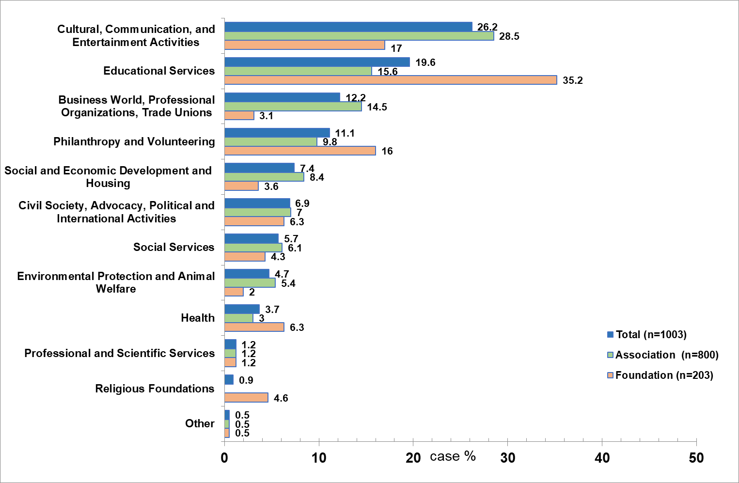
Field of Activity

Slide 7
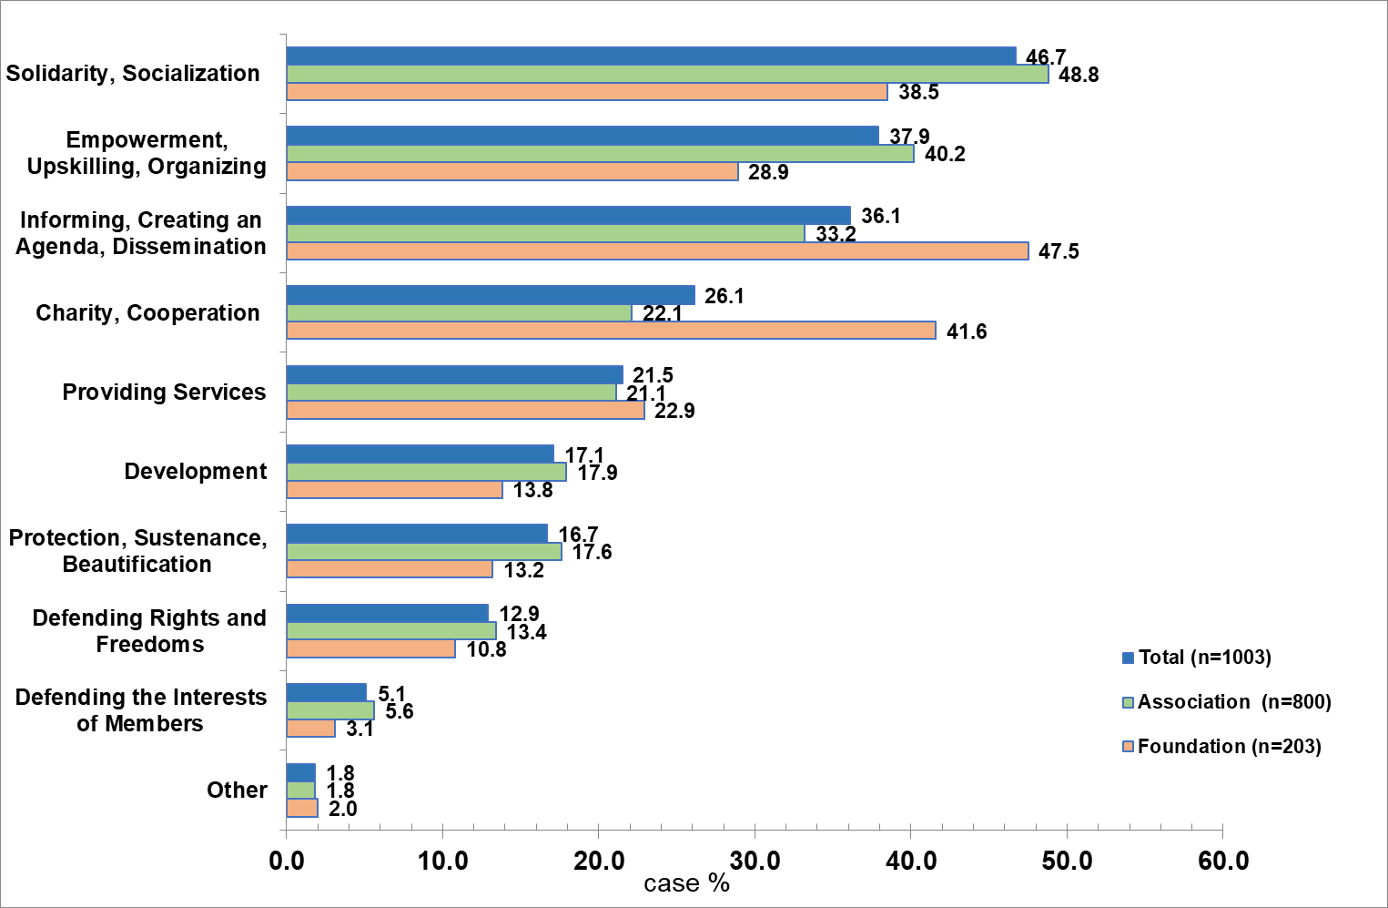
The Founding Objectives

Slide 8
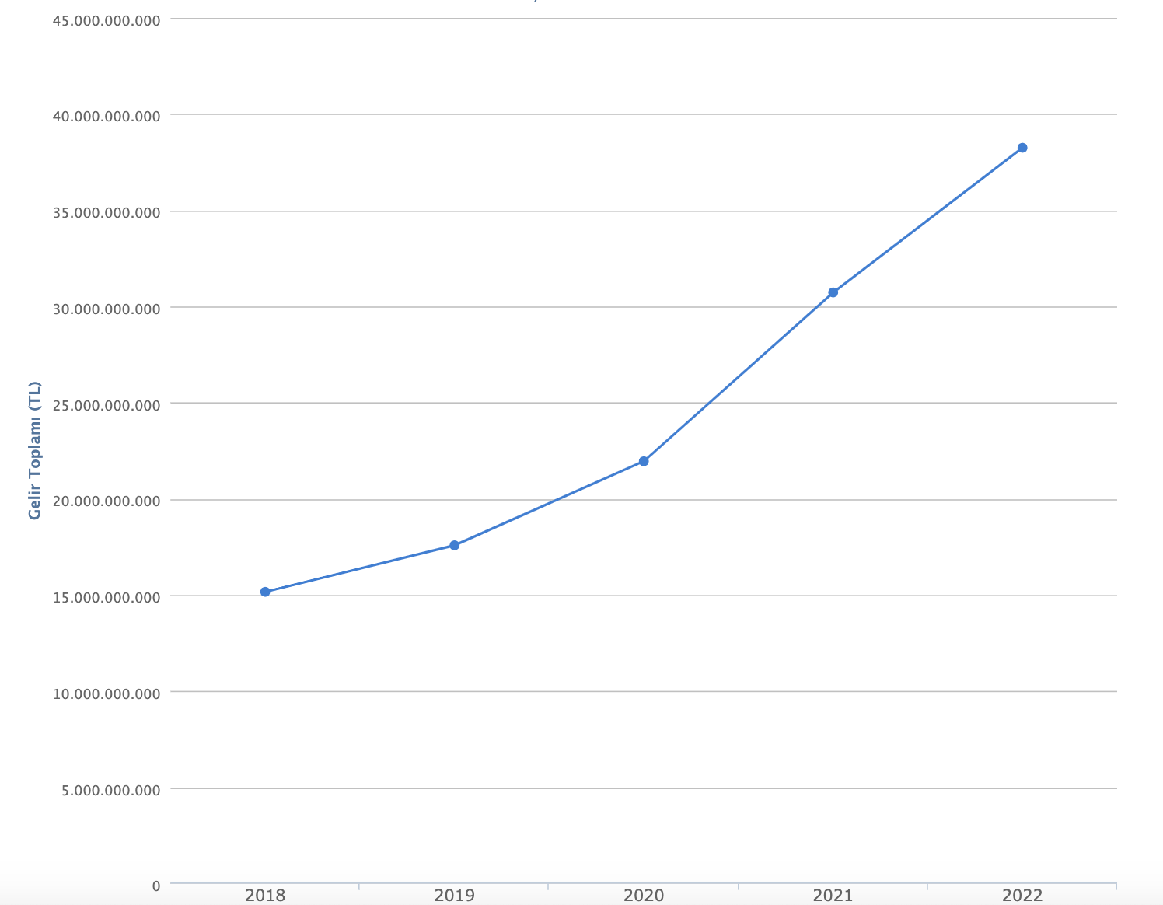
Total income of associations in TL years 2017-2021
2018: app. 3 Billion Eur
2021: app. 3 Billion Eur
2022: app. 2.5 Billion Eur

Slide 9
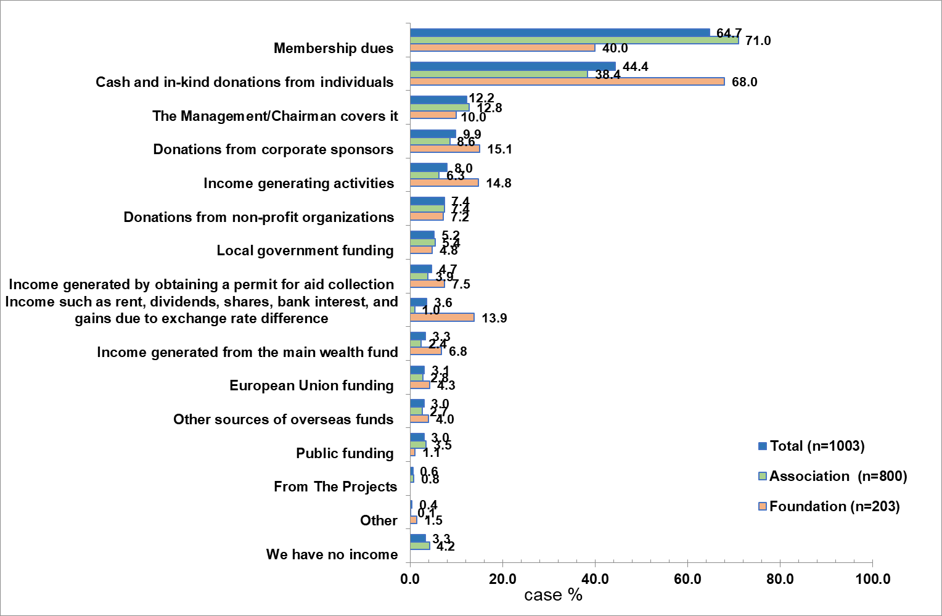
Financial Resources

Slide 10
CSO profile
Young: More than 70 percent of CSOs were founded in 2011 or later. The average founding age is 11
Young people are the most important target group of CSOs (40%).
Amateur: 77 percent of CSOs have no paid full-time staff.
Volunteer: CSOs carry out their activities mainly with volunteers. The average number of volunteers is 67.
Local: Nearly 80 percent of CSOs operate at the district and provincial levels.
Modest: The income level of about 50% of CSOs is below 10,000 TL (500 euros).
3.5% of CSOs have an income of more than 1 million TL. (Foundations 12.3%, associations 1.3%)

Slide 11
CSO profile-2
Member-based: The most important income items are membership fees (65%) and donations (45%).
Not inclined to business: Only 6,5% of the CSOs have economic enterprises.
Mobile: 25% of CSOs do not have an office.
Solidarist: The most frequently cited founding purpose was "solidarity and socialization" at 47%.
"empowerment, skills acquisition, organization" (38 percent) and
"information, agenda setting, dissemination" (36 percent).
Rights-based approach on the rise: It is estimated that about 13% of CSOs have a rights-based approach.

Slide 12
Enabling environment/freedom of association
35% of CSOs have been audited by public institutions in the last two years.
4.2% of CSOs received fines as a result of inspections.
Rights-based CSOs are more likely to be inspected.
Rights-based CSOs report that they face more pressure than other groups for their critical statements
and engage in more self-censorship.
Rights-based CSOs build more relationships with public institutions,
but they are much more critical of public-civil society relations and have much more negative perceptions.

Slide 13
Participation in decision-making processes and relations with public institutions
14% of CSOs can benefit from tax advantages.
5.5% of CSOs are able to receive government support in cash or kind.
6% of CSOs benefit from grant programs by international donors.
About 18% of CSOs can participate in consultation processes conducted by public institutions.
  Most interaction is with municipalities (42%).

Slide 14
The role and activities of STGM in CSO Governance in Turkey

Slide 15
Association of Civil Society Development Centre
Vision
A strong and democratic civil society
Mission
To ensure the development of participation and democracy in civil society,
To strengthen organisational capacity and autonomy,
To make the voice of civil society heard in decision making processes,
To carry out capacity building activities, advocacy, campaign, research, and lobbying activities in its priority target areas

Slide 16










Association of Civil Society Development Centre
Empowering NGOs with IT project (Microsoft Cybergrant Unlimited Potential Grant Program )
Triple A for Citizens (EU FPA grant)
RESOURCE CENTRE FOR CSOS IN TURKEY
FREEDOM OF
ASSOCIATION PROJECT
ACTIVE PARTICIPATION PROJECT
CSDP
2004
2007
2011
2014
2018
2002
2005
2009
2012
2017
FREEDOM OF ASSOCIATION AND RIGHT TO PARTICIPATION
DIALOGUE PROJECT
CSO Trainings in Turkey Project (Olof Palme Center support)
CS-PUBLIC SECTOR COOPERATION PROJECT
OPERATIONAL GRANT PROGRAMME: BİRLİKTE
Grant Facility
Establishment of Local Support Centers
Armenian-Turkish NGO Forum Project (British Council support)

Slide 17
Association of Civil Society Development Centre
Capacity Building
Activities
Grant Schemes
Monitoring and Advocacy

Slide 18
Association of Civil Society Development Centre
28 CSO Projects in 2005-2022
8 Grant Schemes
7 million Eur
# of Grant Project: 228
450+
Training
for CSOs
10.000 + CSOs Benefitted

Slide 19
SELF REGULATION FOR CIVIL SOCIETY
An inquiry for the conditions of a Civil Code of Conduct/Ethics as a Self-regulation Initiative For Civil Society In Turkey, 2020-2021

Slide 20
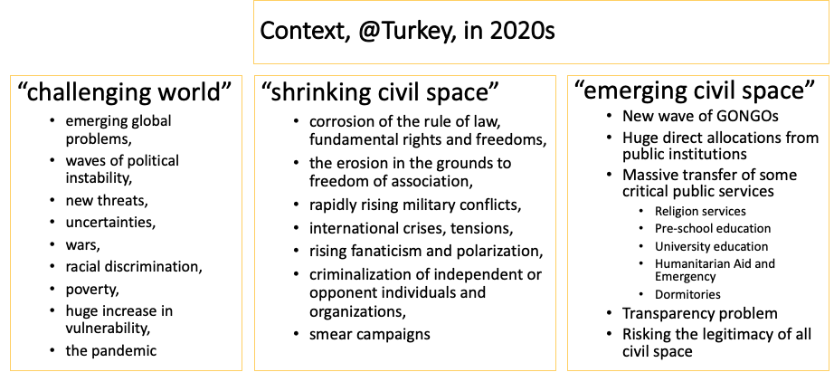

Slide 21
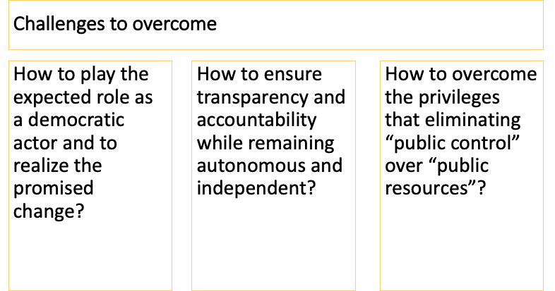

Slide 22
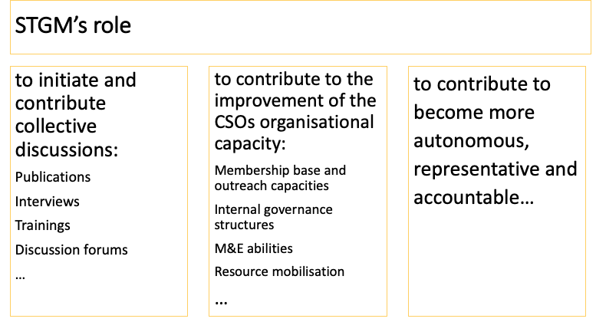

Slide 23
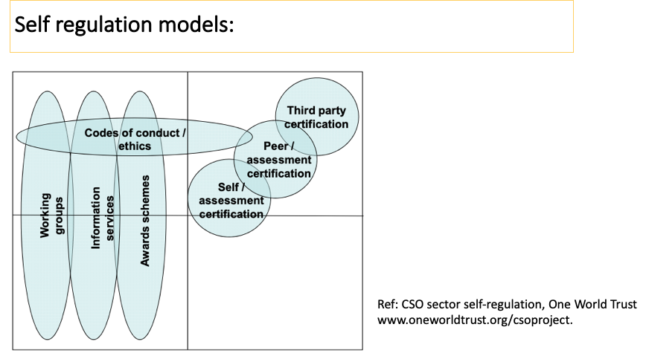

Slide 24
“SÖZ”
An inquiry for the conditions of a Civil Code of Conduct/Ethics as a Self-regulation Initiative For Civil Society In Turkey
METHODOLOGY AND FINDINGS
The acronym SÖZ, was particularly preferred for the implications of its synonymous concepts of “statement”, “sayings”, “word” and lastly “promise” in Turkish language.
The SÖZ study has been conducted in line with the following goals, as:
to promote transparency and accountability;
to increase the credibility with donors and public;
to provoke the participation of stakeholders and enhance networking;
and to reflect the genuineness of the local context, which is the civil space in Turkey.

Slide 25
SÖZ STUDY
Semi-structured interviews
Focus groups
Concept map
Recap groups
SÖZ principles and indicators
Assessment questions

Slide 26


How would you list the principles on which your organization is attached? How did you determine these principles? What needs do you think they meet?
“...we are concerned with standardisation.Compliance with internal control is important ...”
“...Açık Açık donor rights statement yet it is not enough to put the reports on the website for transparency. We give account to different stakeholders...”
“...’not stuck like living in space’; ‘not to make big words’; in Turkish civil society reality to create local-specific language, concepts can be tried to express something in your locality…”
“...While determining the principles, the expectations of different institutions are also determining, but for us, the principles were revealed before the expectations. Principles, policy documents, etc. In fact, it is formed by the interaction between the field and the office....”
“...we adopt an universal and rights-based approach;political harmony alone is not enough, we care about institutionalization ...”
Notes:
international standards problem in compliance, multi sources, common CoC need

Slide 27
4 focus group meetings
Please complete the following sentence with a single statement:
Our primary responsibility as a CSO is ……………………………………………………………………………………………………...
“...first of all, to ensure that our target group,live as free as possible…”
“...fundamental rights and freedoms ... to the ground rules…”
“...to the targeted beneficiary group;to yourself; to the members; to the beneficiary group…”
“...first to its founding principles and then to its target group…”
“...ensuring the participation of all social groups…”
Notes:
target group+ grounding rules, socety

Slide 28
4 focus group meetings
Please complete the following sentence with a single statement:
The future of an CSO operating in Turkey depends on …………………………………………
…………………………………………………………………………………………………………...
“...sustainability of the state…”
“...to the future of the country…”
“...the solidarity and determination of civil society,…”
“...politics…”
“...democracy…”
“...democracy…”
“...politics…”
“...politics…”
“...democracy…”
“...to being free and independent…”

Slide 29
4 focus group meetings
What is the sine qua non principle for the CSO you represent?
……………………………………………………………………………………………………………
“...honesty and sincerity…”
“...reliability…”
“...equality…”
“...consistency…”
“...volunteering…”
“...being unselfish…”
“...transparency…”
“...social respect…”
“...being active…”
“...respect…”

Slide 30
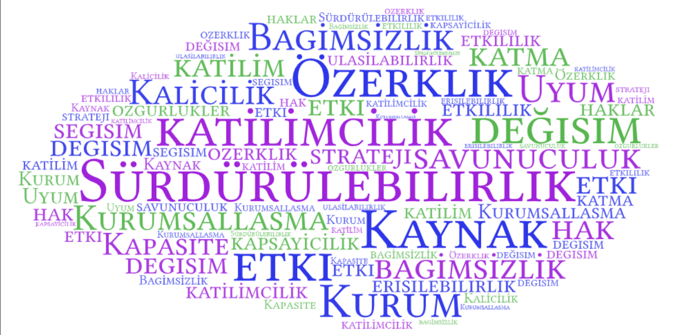

Slide 31
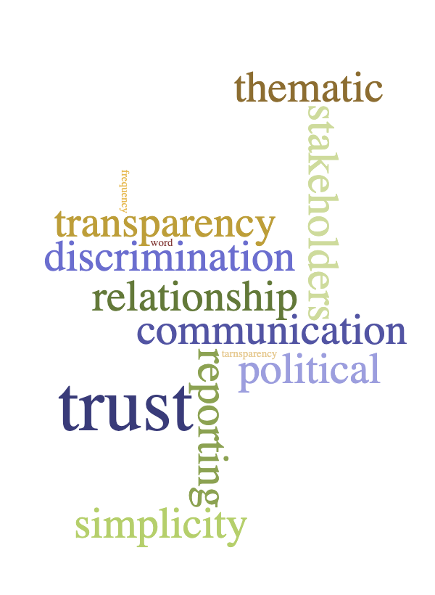
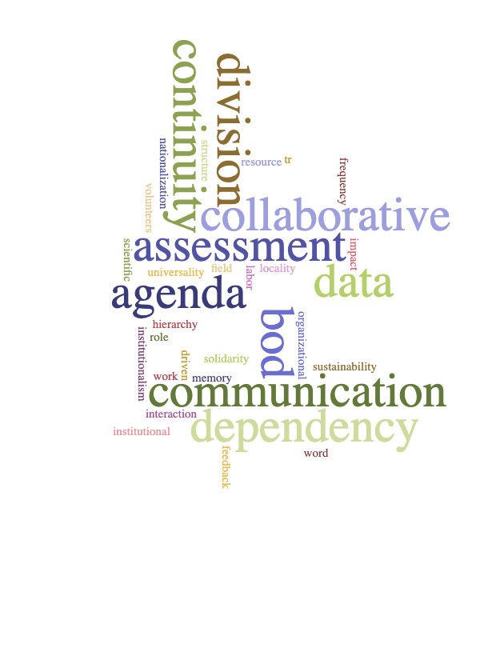
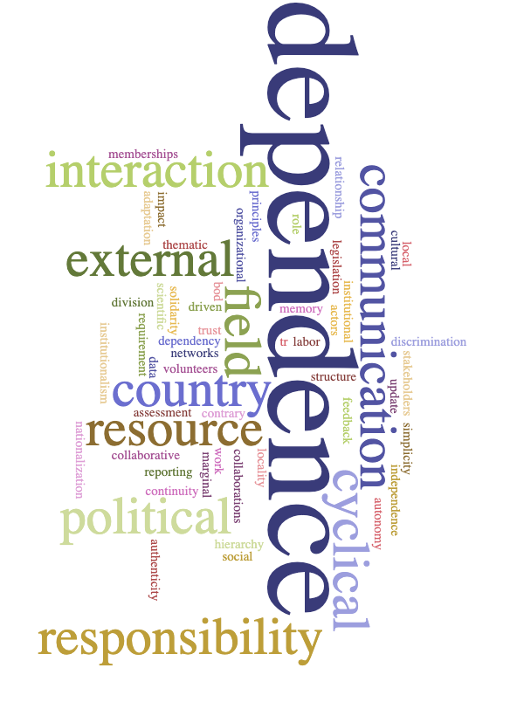
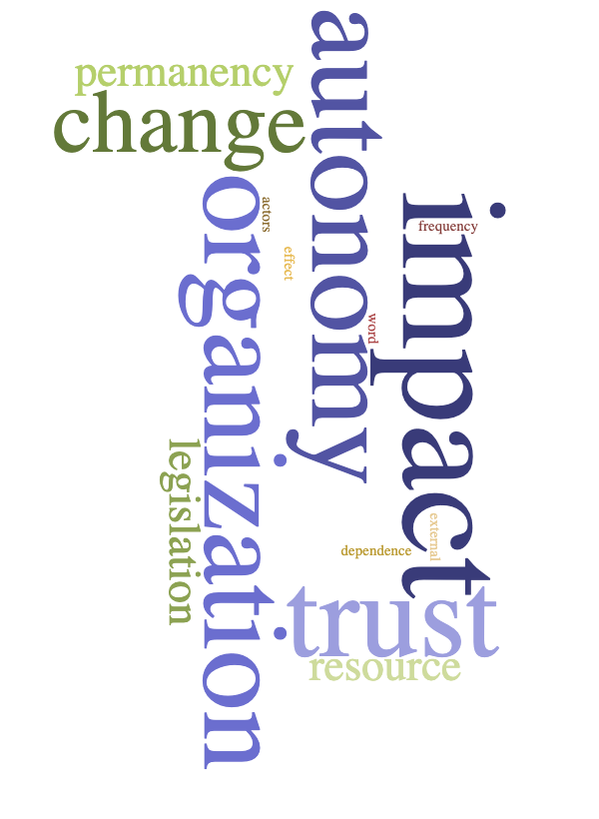
Concept mapping for the principles and indicators

Slide 32
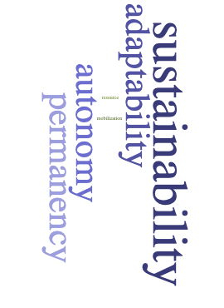
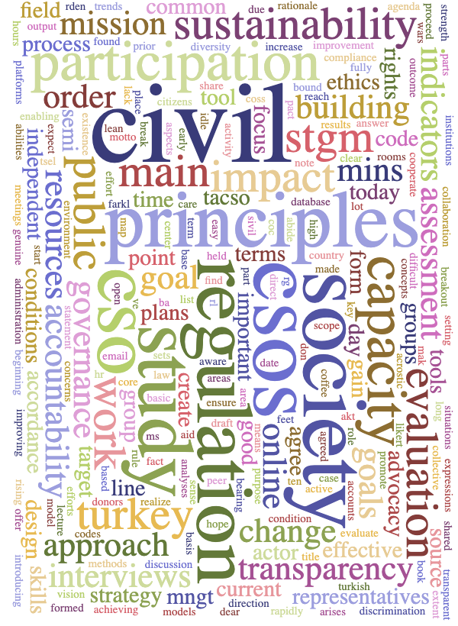



Concept mapping for the principles and indicators

Slide 33
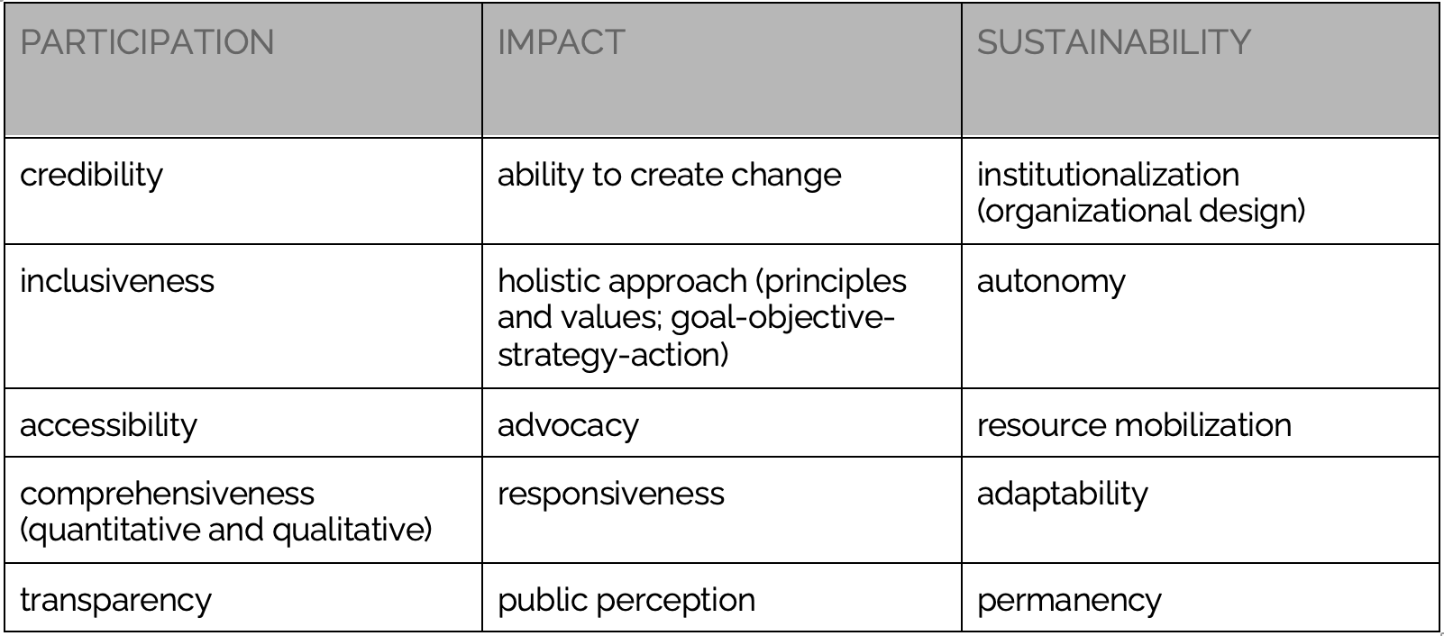

Slide 34
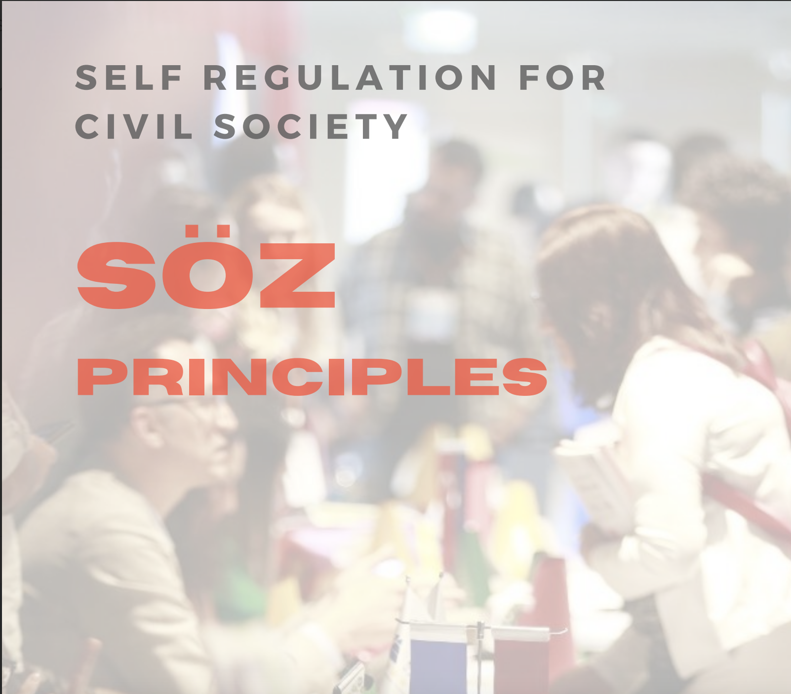


Slide 35
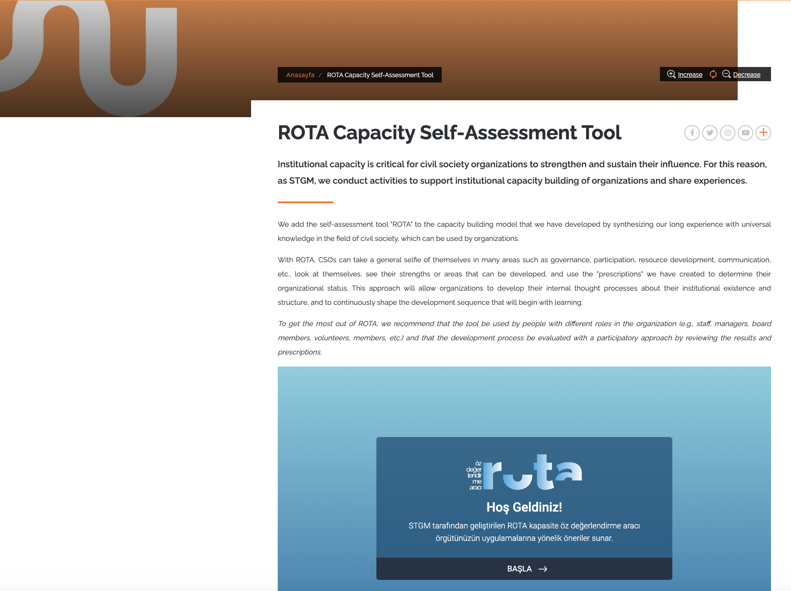
https://www.stgm.org.tr/en/rota-capacity-self-assessment-tool

Slide 36
Further Steps
Updating Guidelines
Exchange meetings in 50 provinces - September 2023 - 2024
Finalising the Principles
National gathering - September 2024

Slide 37
Thanks for questions
:)

