Slide 1

Freedom of expression
and civil society
The dire state of press
freedom in Türkiye
YUSUF KANLI
Vice Chair, Association of Journalists
31 MAY 2023
Podgorica, Montenegro

Slide 2
“Freedom of the press is essential to a democratic society. To uphold and protect it, and to respect its diversity and its political, social and cultural missions, is the mandate of all governments.”
Article 1- European Charter on Freedom of the Press

Slide 3


Developments & Context in Turkey
Back sliding in freedom of expression and freedom of the press indexes
  World Justice Project: 2023 ranked 134th place
  Freedom House, March 2023: “Not-Free Country”
  Reporter Without Borders, 2023: 2023 ranked 165th place

Slide 4
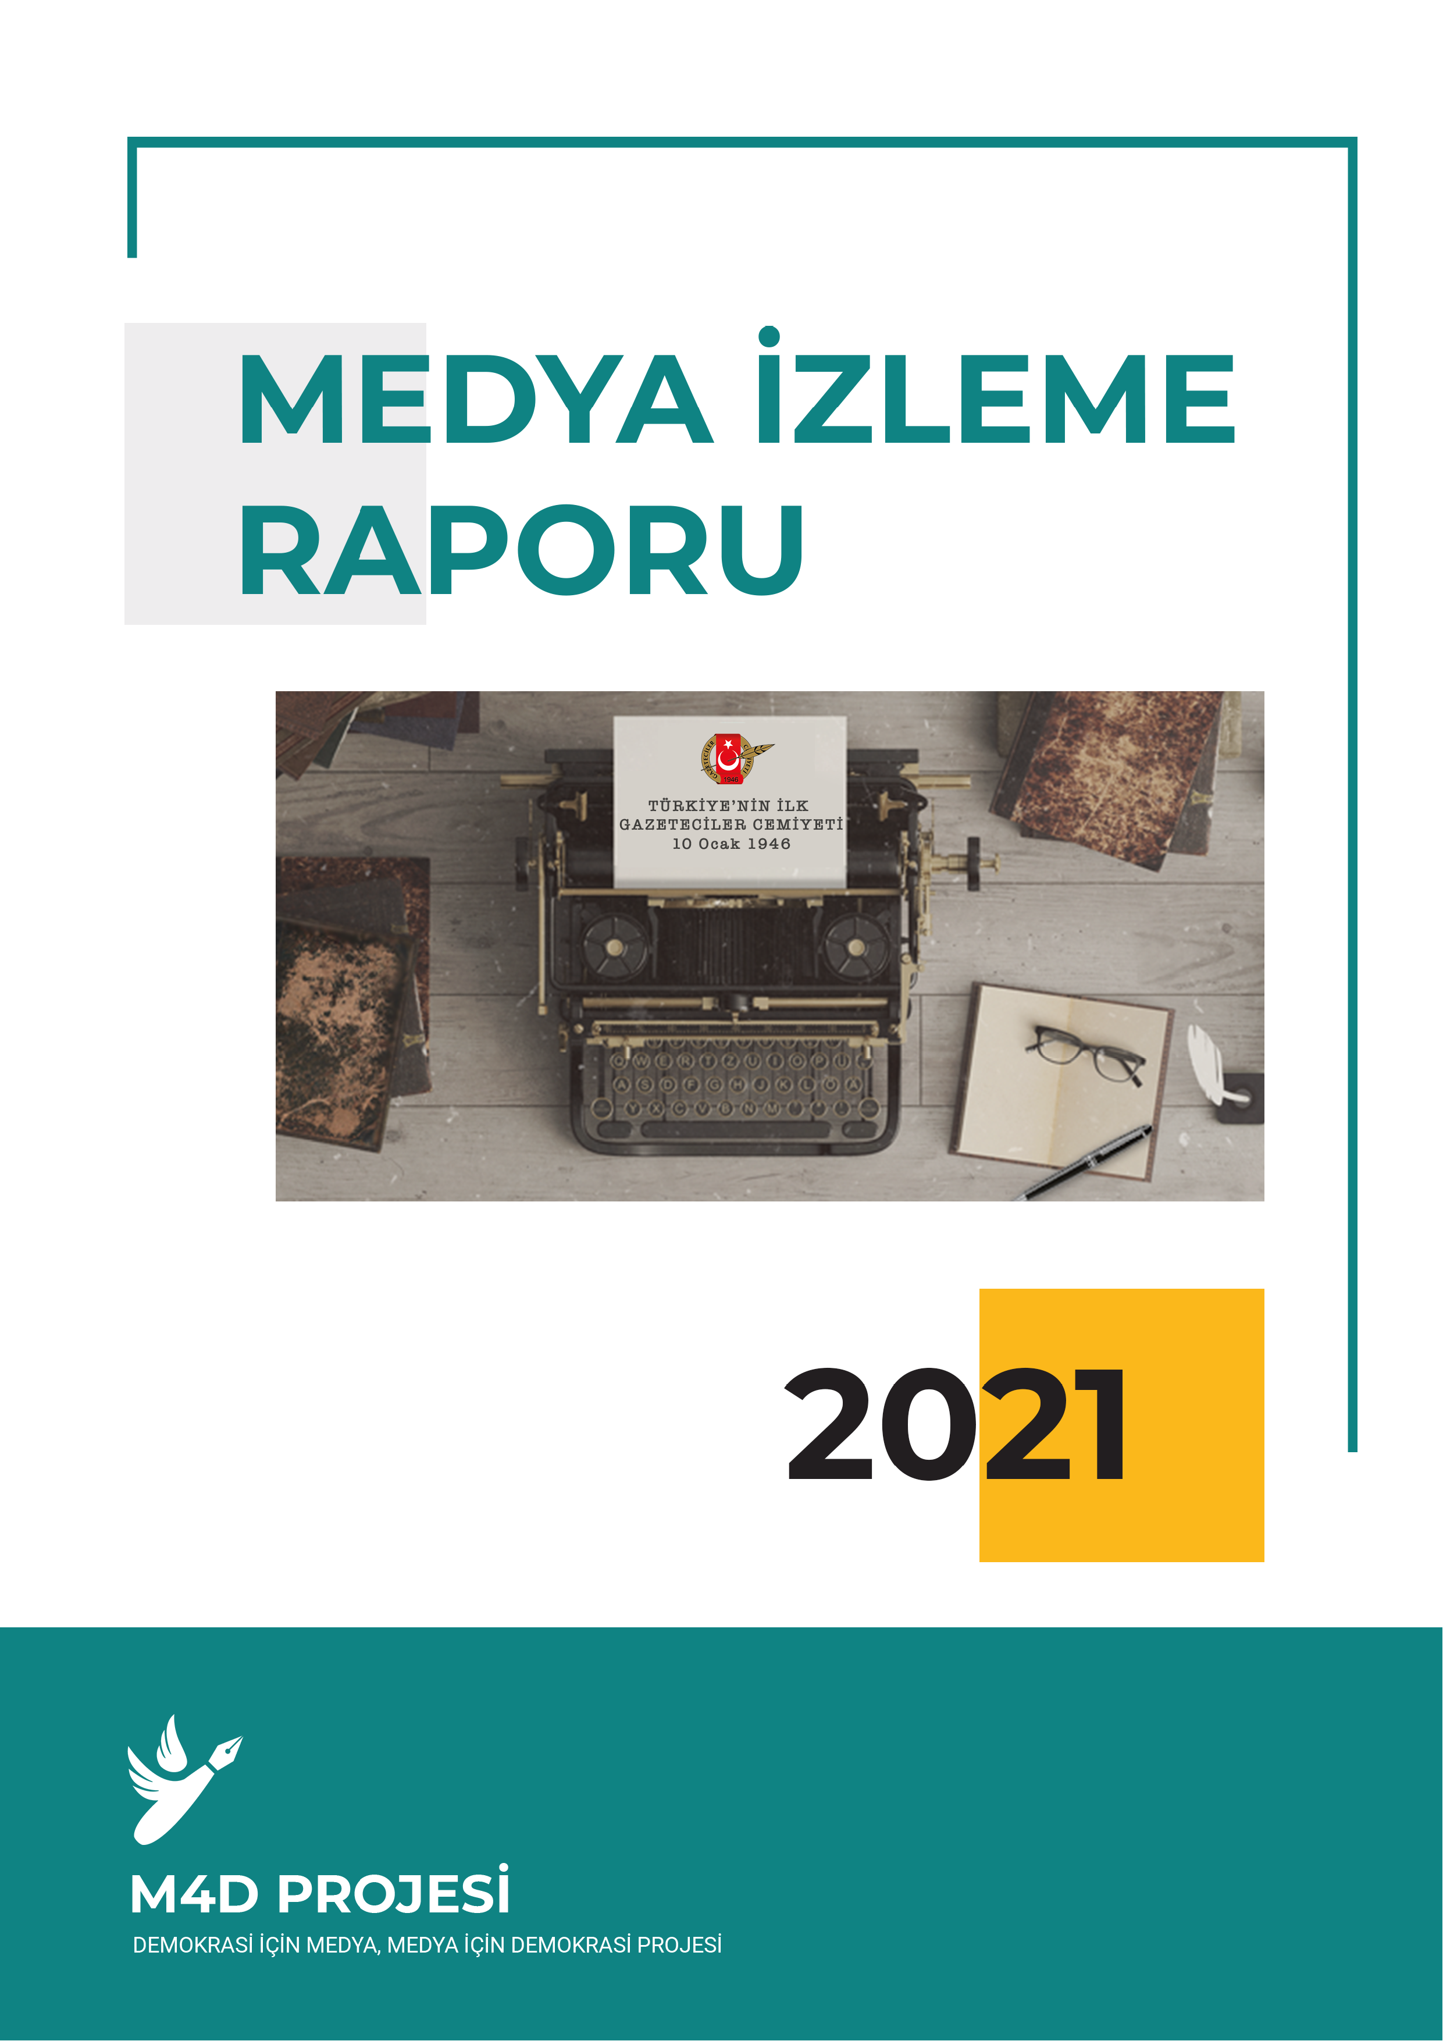



Developments & Context in Turkey
Increased political pressure by the government and state institutions
78 journalists were taken into custody
61 journalists were physically assaulted
At least 50 media outlets and journalists were targeted

Slide 5
Developments & Context in Turkey
Economic turmoil & worsening work conditions for journalists
Year | 2017 | 2018 | 2019 | 2020 | 2021 | 2022
Number of Newspapers | 1122 | 1116 | 1075 | 1051 | 997 | 964
Professionals | 8858 | 8683 | 7593 | 7204 | 6969 | 6687
Number of Press Cards | 3717 | 3667 | 3211 | 3108 | 3260 | 2898

Slide 6

Key Challenges
Accreditation measures & increased unemployment
Legislation restricting press freedom
Lack of pluralism in the media sector/Uniform media
Lack of funding opportunities for alternative media outlets and freelance journalists

Slide 7
Our Approach, Impact & Future Prospects
Facilitating democratic participation
Capacity development
Empowerment
Resilient journalists & media outlets

Slide 8



Our Approach, Impact & Future Prospects
Sub grants: 85 in the past term and 29 in the current period
Advocacy: National and international advocacy actions
Agency: Beneficiaries were able to empower themselves

Slide 9
Thank you.
Yusuf Kanlı
Vice Chair- Association of Journalists
Email: yusufkanli@media4democracy.org

