Slide 1
DG NEAR Guidelines
Baseline Assessment Report 2021
Key Findings: Specific Objective 3
Snježana Bokulić
1 June 2023
Podgorica, Montenegro

Slide 2
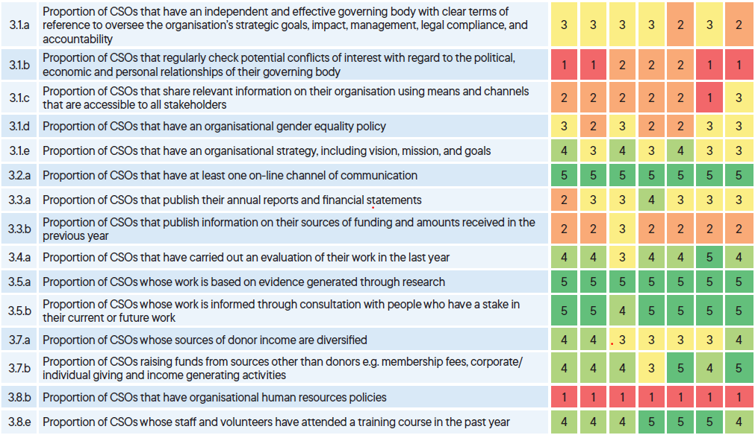
CSO capacity and accountability – no time for complacency

Slide 3
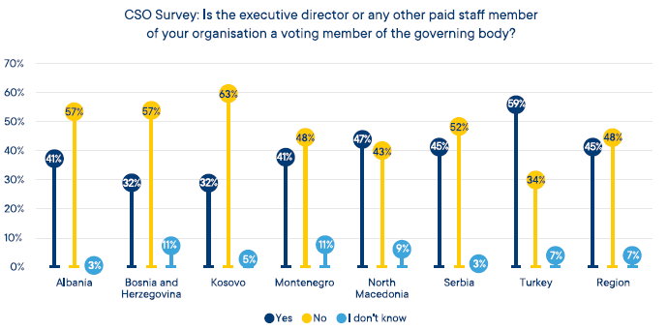
Proportion of CSOs with a paid staff member as voting member of the board

Slide 4
Proportion of CSOs publishing annual reports and financial statements
Proportion of CSOs that publish annual reports and financial statements
Albania | Bosnia and Herzegovina | Kosovo | Montenegro | North Macedonia | Serbia | Türkiye
29% | 55% | 38% | 46% | 55% | 41% | 42%

Slide 5
Proportion of CSOs whose sources of donor income are diversified
Proportion of CSOs whose sources of donor income are diversified
Albania | Bosnia and Herzegovina | Kosovo | Montenegro | North Macedonia | Serbia | Türkiye
63% | 62% | 53% | 45% | 51% | 58% | 62%

Slide 6
>>
Thank you for the attention
>>

