Slide 1
DG NEAR Guidelines
Baseline Assessment Report 2021
Methodology and Key Findings
Snježana Bokulić
31 May 2023
Podgorica, Montenegro

Slide 2
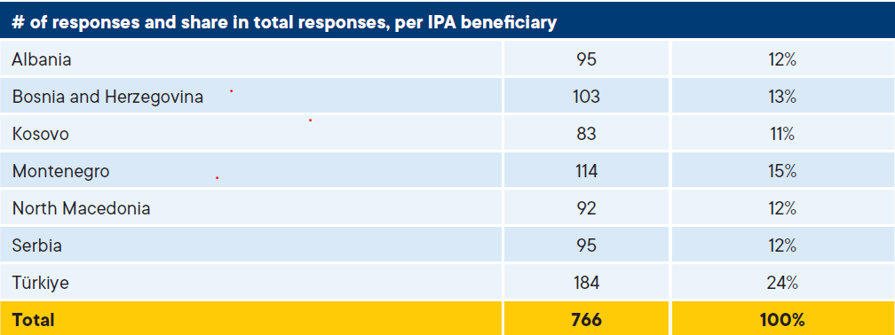
Baseline assessment methodology
Survey of CSOs: 766 valid responses
  Focus group discussions

Slide 3
Baseline assessment methodology
Survey of public authorities: 76 valid responses
Legal analysis
Document review
36 indicators assessed
Validation workshops

Slide 4
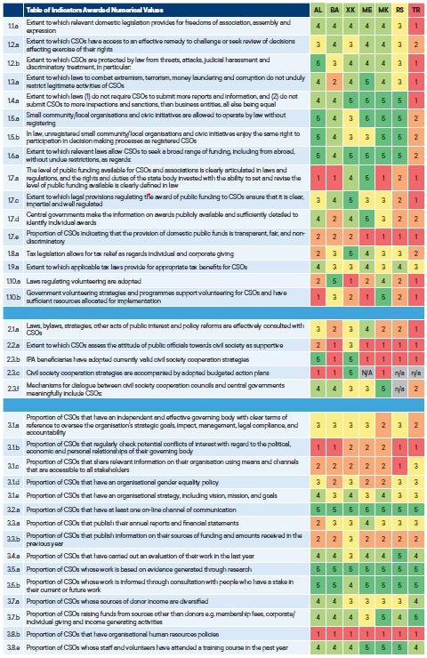
Baseline assessment methodology

Slide 5
Some observations
59 indicators
Qualitative v. quantitative
CSO survey: CSOs – NGOs
Where next?

Slide 6
Key findings: Specific Objective 1
Conducive environment for civil society
Legal framework generally in line with standards
Issues arising:
  Public funding
  Tax legislation
  Volunteering

Slide 7
Key findings: Specific Objective 2
Cooperation between CSOs and public institutions
Dearth of civil society cooperation strategies
Lack of trust in public officials by CSOs
Mixed picture of CSO participation in decision- and policy-making processes

Slide 8
Key findings: Specific Objective 3
CSO capacity and resilience
CSO governance insufficiently accountable
Insufficient financial transparency
Strong research, evaluation and stakeholder consultation
Sound financial sustainability
Weak human resources but investment in staff and volunteers

Slide 9
>>
Thank you for the attention
>>

