Slide 1
DG NEAR Guidelines
Baseline Assessment Report 2021
Key Findings: Specific Objective 1
Snježana Bokulić
31 May 2023
Podgorica, Montenegro

Slide 2
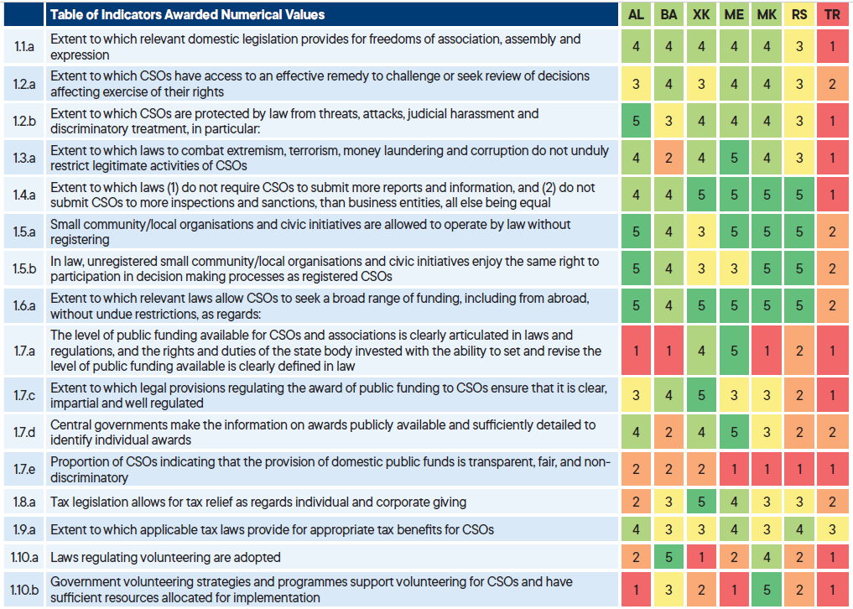
Enabling environment – a civil society under pressure

Slide 3
Transparent and fair public funding
Proportion of CSOs indicating that the provision of domestic public funds is transparent and fair
Albania | Bosnia and Herzegovina | Kosovo | Montenegro | North Macedonia | Serbia | Türkiye
21% | 14% | 18% | 10% | 5% | 10% | 9%

Slide 4
>>
Thank you for the attention
>>

