Slide 1
DG NEAR Guidelines
Baseline Assessment Report 2021
Key Findings: Specific Objective 2
Snježana Bokulić
31 May 2023
Podgorica, Montenegro

Slide 2
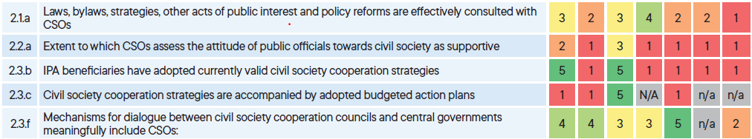
Government – civil society cooperation: a win-win if we can make it happen

Slide 3
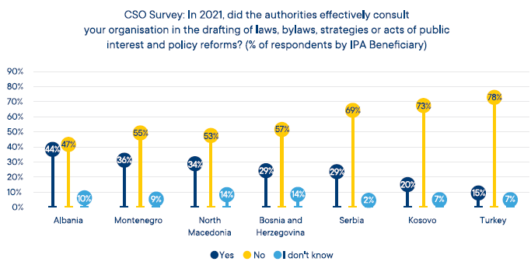
Effective consultation of CSOs

Slide 4
Public official support for civil society
Proportion of CSOs indicating that public officials were not at all supportive or insufficiently supportive towards civil society
Albania | Bosnia and Herzegovina | Kosovo | Montenegro | North Macedonia | Serbia | Türkiye
55% | 80% | 57% | 79% | 73% | 81% | 72%

Slide 5
>>
Thank you for the attention
>>

