Slide 1

CSO FORUM 2023
Group 3: Governance and accountability
Afërdita Pustina, Country Coordinator for Kosovo, EU TACSO 3
01 June 2023
Podgorica, Montenegro

Slide 2
AGENDA
General overview on Governance and Accountability
Contributions by Mr. Tezcan Eralp Abay, Association of Civil Society Development Centre (STGM), Turkiye and Ms. Arjola Agolli, Code of Standard for CSOs in Albania
Q&A throughout session

Slide 3
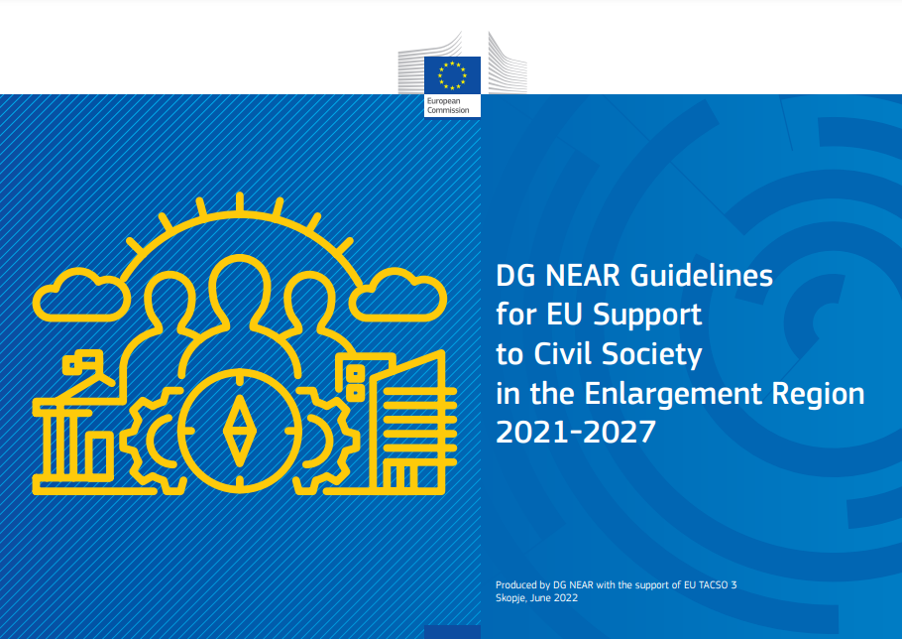
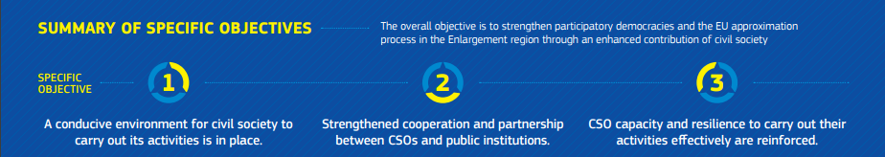
Governance and accountability

Slide 4
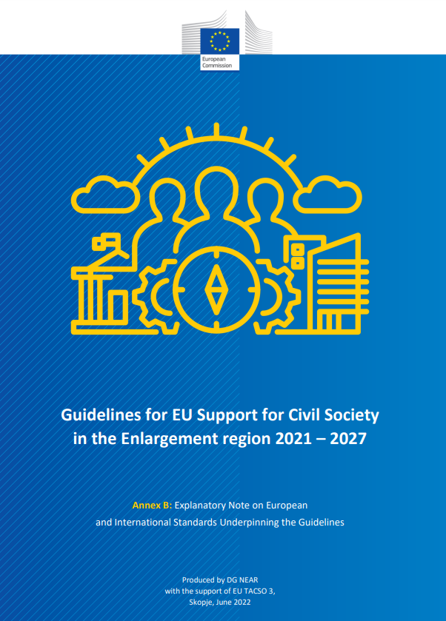

Measurement criteria

Slide 5
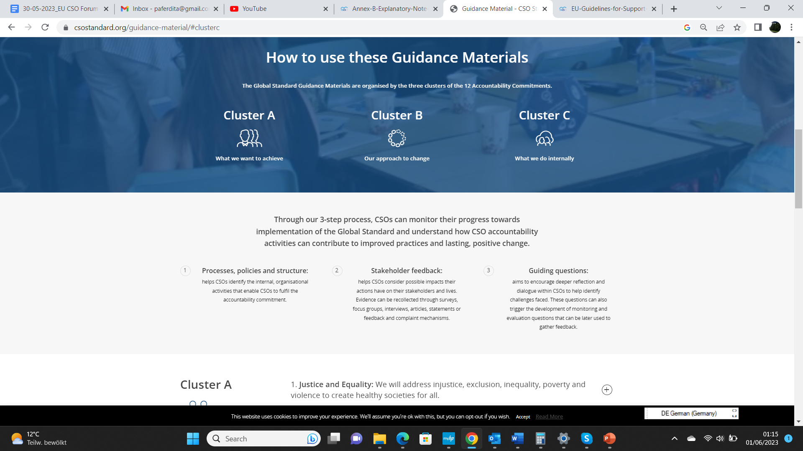
It is a reference standard that aims to transform how organizations understand and practice accountability.

Slide 6
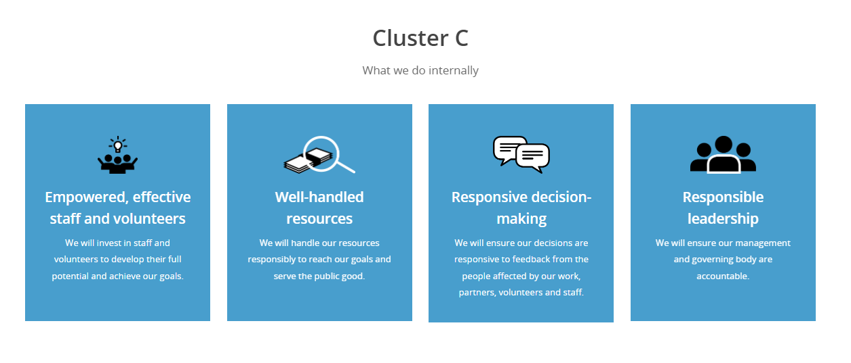

Slide 7
Commitment 12: Responsible Leadership
Key actions: Ensure an independent governing body oversees our strategic direction, legal compliance, risk management and performance, hold governing body and management equally accountable for delivering on our strategic goals, nurture a culture of accountability and support responsible, visionary and innovative leadership at all levels, take internal and external complaints and disputes seriously.

Slide 8
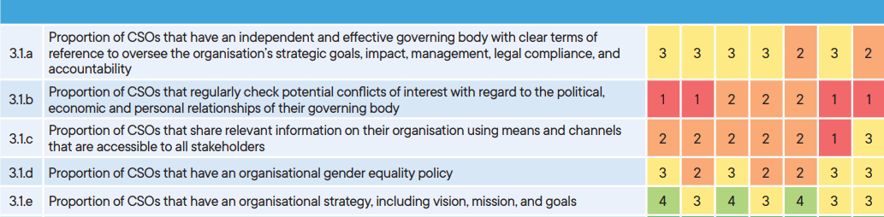
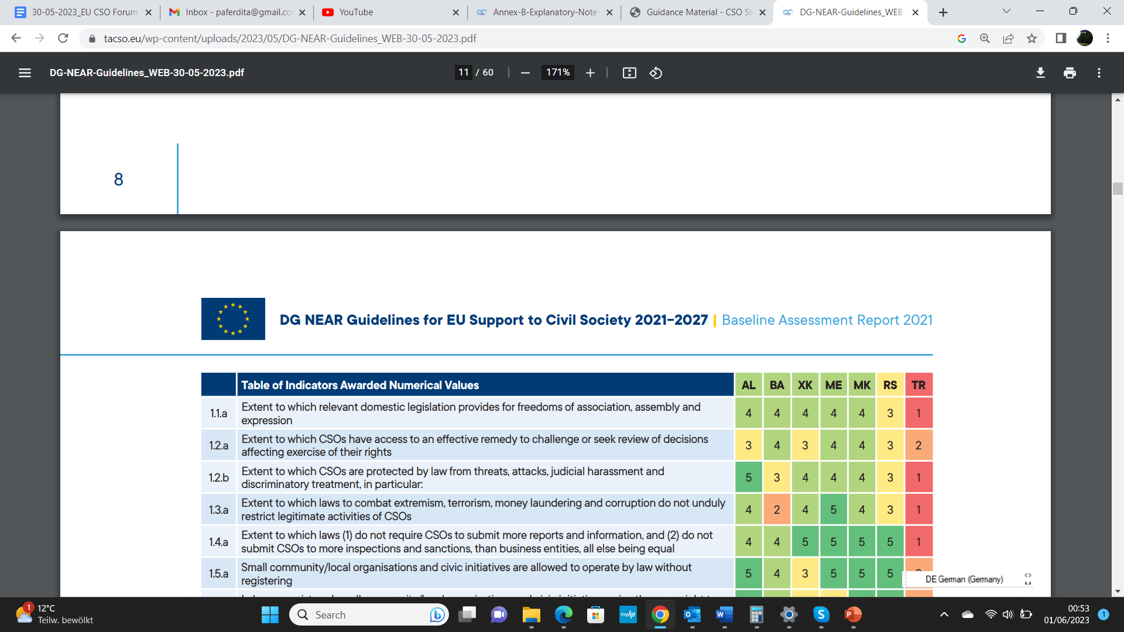
FINDINGS OF BASELINE ASSESSMENT REPORT 2021

Slide 9
FINDINGS OF BASELINE ASSESSMENT REPORT 2021 (continued)
The implementation of good governance standards overall is low. Governing bodies have clearly articulated governance documents, but they are not independent.
A significant proportion of CSOs report that paid staff members are, at the same time, decision-making members of the boards.
Although a significant proportion of CSOs has a website, and most have a social media presence, the proportion of CSOs that publish relevant information about their organisational governance, policies, annual reports, financial statements and sources of funding is low.

