Slide 1
LOCAL DEMOCRACY
Municipality – CSO cooperation
Dr. ITIR AKDOĞAN
31.5.2023
Podgorica, Montenegro

Slide 2
Local cooperation
City stakeholders
Planning
Implementing
Monitoring and evaluating

Slide 3
Important because
Informed decision
Shared responsibility
Increased efficiency
Increased monitoring
>> better governance

Slide 4
Critical issues
Political cultural
Legal
Technical

Slide 5
Municipalities should
Prioritize utilizing CSOs’ democratic capacity
Include more CSO people in city councils
Functionalize citizen assemblies for local democracy
Fight polarization
Communicate regularly with CSOs

Slide 6
Legal framework needs
Including
Participation as a concept
Concrete definitions of
process, documents, steps, calendar
Flexibility in the local

Slide 7

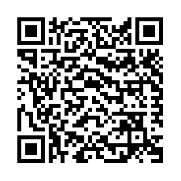

Slide 8
>>
Thank you for the attention
>>

