Slide 1

WRAP UP
1 June 2023
Podgorica, Montenegro

Slide 2
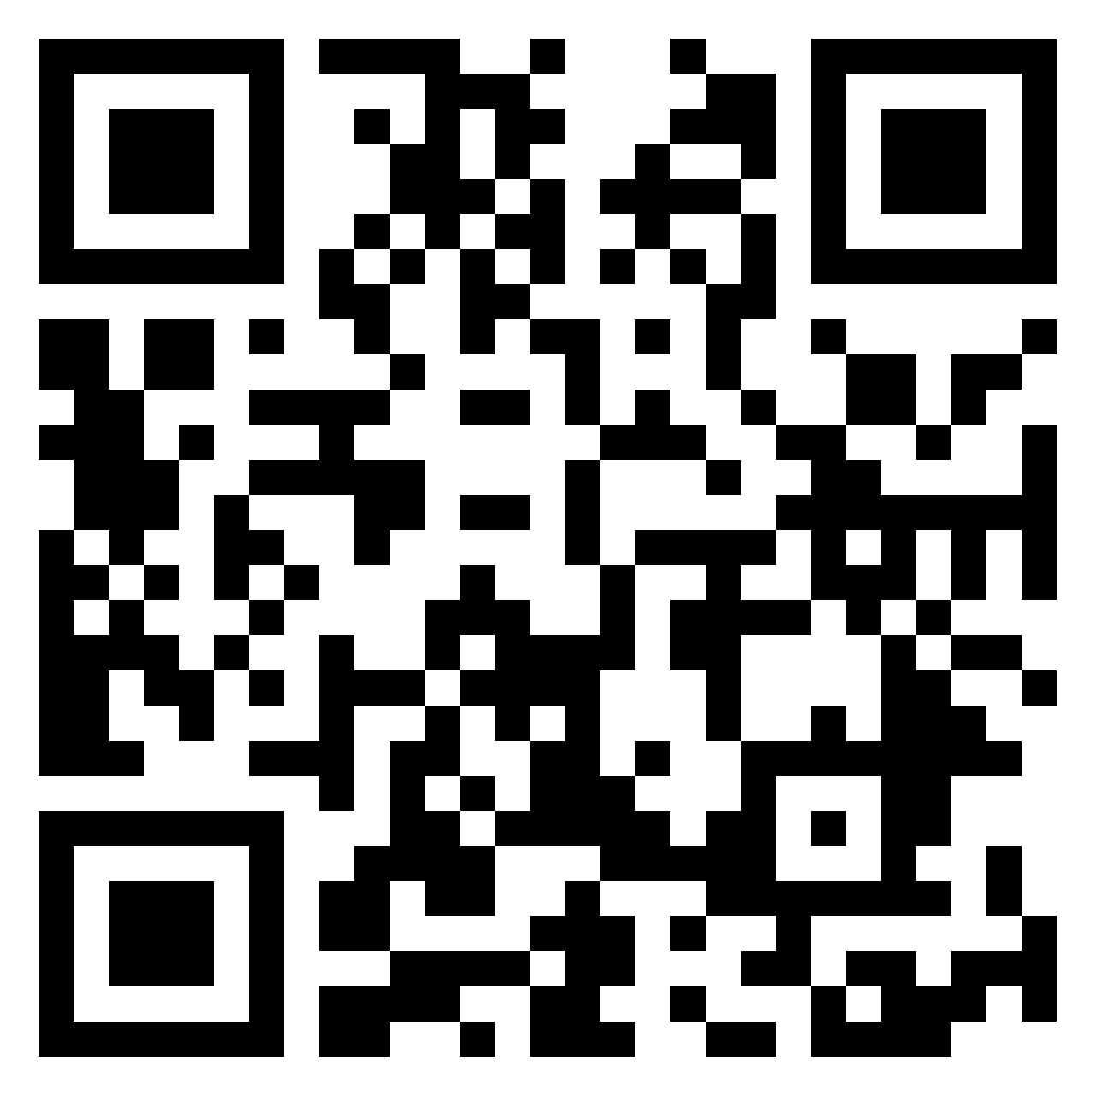
Padlet for your take-aways
1. Enabling Environment for Civil Society
2. Government – Civil Society Cooperation
3. Civil Society Capacities and Accountability

Slide 3
Part 1 – Enabling Environment (day 1)
Plenary: Enabling Environment – a civil society under pressure
10:45 – 12:00
Group 1:
Digital tools for protecting the enabling environment and promoting the Rule of Law.
Group 2:
Safety and security
Group 3: Enabling environment and CSO financial sustainability
12:00 – 13:00

Slide 4
Enabling Environment
Comprehensive documentation of rights violations is essential for monitoring and advocating for improvements in the enabling environment
Open data at local level can better demonstrate benefits if central governments unwilling to open their data
For safety - make visible all rights violations – through WBT CSO networks, access to media and international organisation
Financial sustainability – share more information to public on revenues, especially about local and individual donations; not just donor funded

Slide 5
Part 2 – Government – civil society cooperation (day 1)
Plenary: Government-civil society cooperation – a win-win if we can make it happen
14:15 – 15:30
Group 1:
Use of digital tools to increase public engagement
Group 2:
Green Agenda and regional cooperation
Group 3:
Local cooperation in the provision of services for local communities’
development
16:00 – 17:00

Slide 6
Government civil society cooperation
Advocacy rooted in evidence (and patience and persistence) is more likely to influence policy – even if not acknowledged
Digital tools need to be accessible and simple for citizens to use, and safe and secure
Green agenda without grass-roots organisations will be just another empty topic
Supporting and encouraging mobilisation of people – young and older – on local issues is most effective way of engaging people in democratic process

Slide 7
Part 3 – CSO Capacities and Accountability (day 2)
Plenary: CSO capacity and accountability – no time for complacency
09:00 – 10:30
Group 1:
Mainstreaming diversity
Group 2:
Skills for non-profits
Group 3:
Governance and accountability
11:00 – 12:00

Slide 8
CSO Capacities and Accountability
CSO accountability is a key to strengthening the enabling environment and government – civil society cooperation
Appropriate information needed for marginalised groups/people to enable direct involvement in democratic processes
Even basic skills are needed; simple solutions help, but more is needed
Governance…

Slide 9
THANK YOU ALL!
1 June 2023
Podgorica, Montenegro

Slide 10
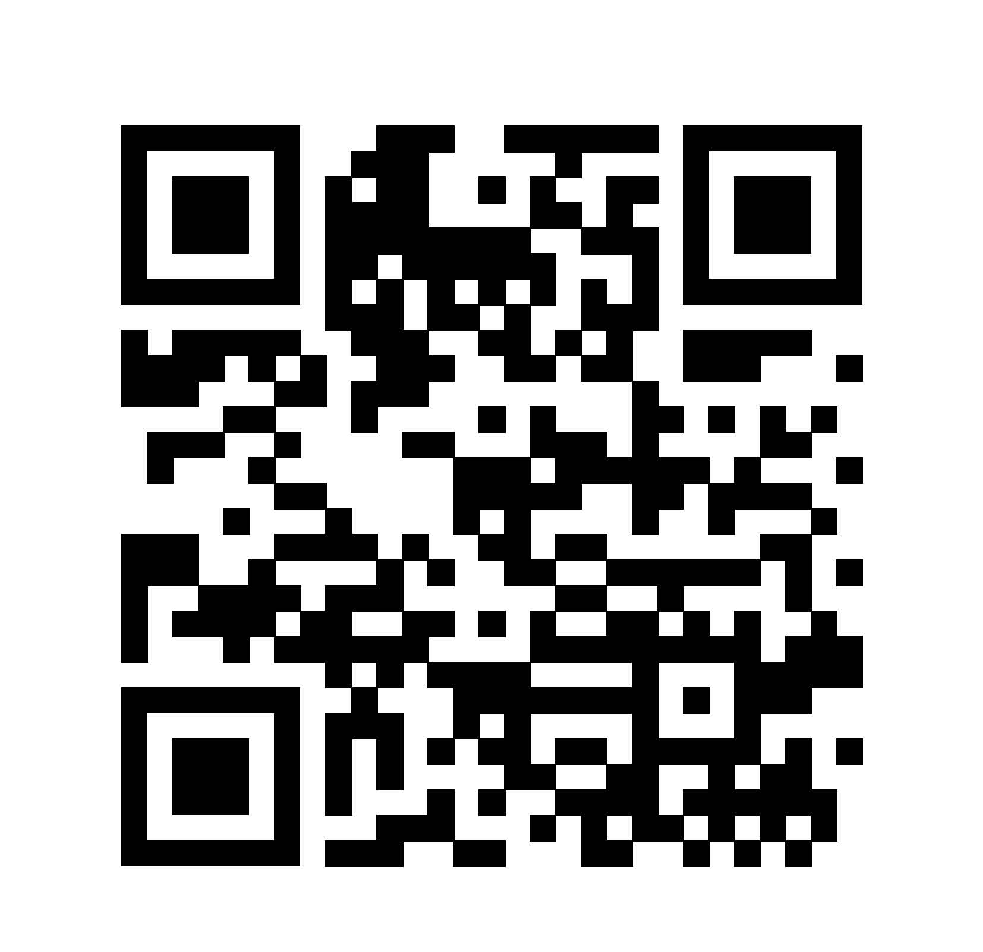
Evaluation form:
https://crm.tacso.eu/node/332
1 June 2023
Podgorica, Montenegro

Slide 11

The Guidelines

Slide 12
What is in the Guidelines?
The Guidelines consist of:
i a set of standards for Authorities and civil society to meet;
ii a set of indicators against which each IPA Beneficiary can be measured to assess its progress in meeting the standards.
The standards are based on regional and international legislation and norms that have already been accepted by all in the Western Balkans and Turkey region.
DG NEAR GUIDELINES FOR EU SUPPORT TO CIVIL SOCIETY IN THE ENLARGEMENT REGION, 2021-2027

Slide 13

Baseline Assessment Report 2021

Slide 14




Assessment against the EU Guidelines
There are 59 indicators defined in the guidelines, linked to sub-objectives
Data to assess performance in each of the IPA Beneficiaries comes from multiple sources, including:
a survey of CSOs
a survey of Government representatives
legal analysis
review of existing research & secondary data
verified through focus groups and consultation.
Research was conducted by an impartial team of experts
A report will be produced periodically.
The baseline year is 2021

Slide 15
What can the Guidelines and the Assessments be used for?
For public authorities:
A framework for Government strategies for cooperation with civil society
Understanding EU expectations for meeting standards regarding civil society in the EU approximation process
Data for monitoring progress in meeting international standards and implementation of civil society cooperation strategies

Slide 16
What can the Guidelines and the Assessments be used for?
For civil society:
Supports a shared view on expected results of EU assistance for enabling environment, government – civil society cooperation and CSOs’ performance and accountability standards
Data, evidence and analysis for assessments of current state of civil society – informing priorities and underpinning funding applications
CSOs’ own development strategies and priorities for strengthening CSO accountability

Slide 17
What can the Guidelines and the Assessments be used for?
For EU:
Assist in designing, implementing and evaluating EU support to civil society – priorities, challenges and what works
Provides analysis of the state of civil society, informs progress assessments for annual EC reporting

Slide 18
And now…

